Slide 1
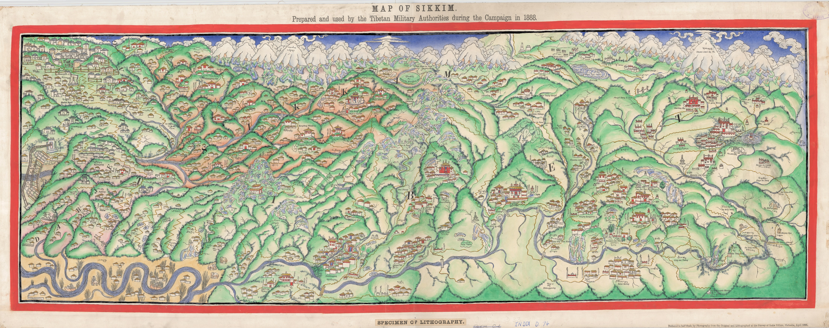
“Map of Sikkim. Prepared and used by the Tibetan Military Authorities during the Campaign in 1888”, mr India D.74 (rgs537334)

Slide 2
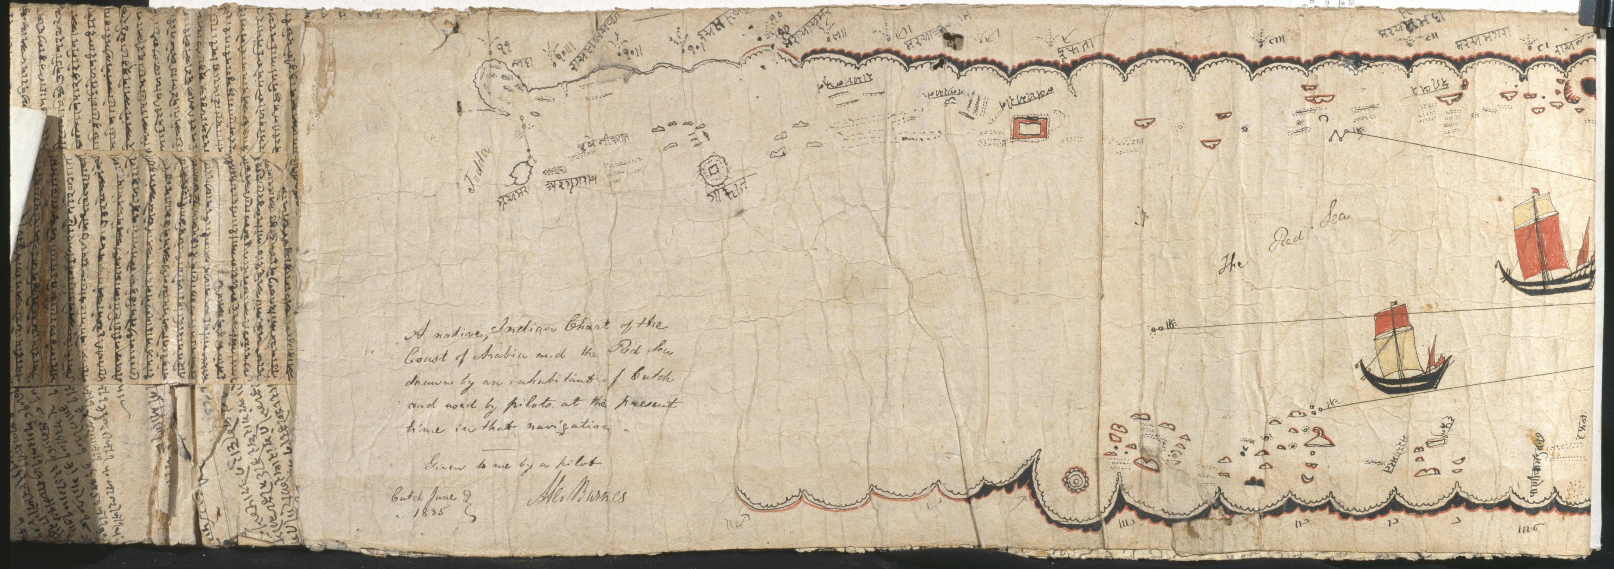
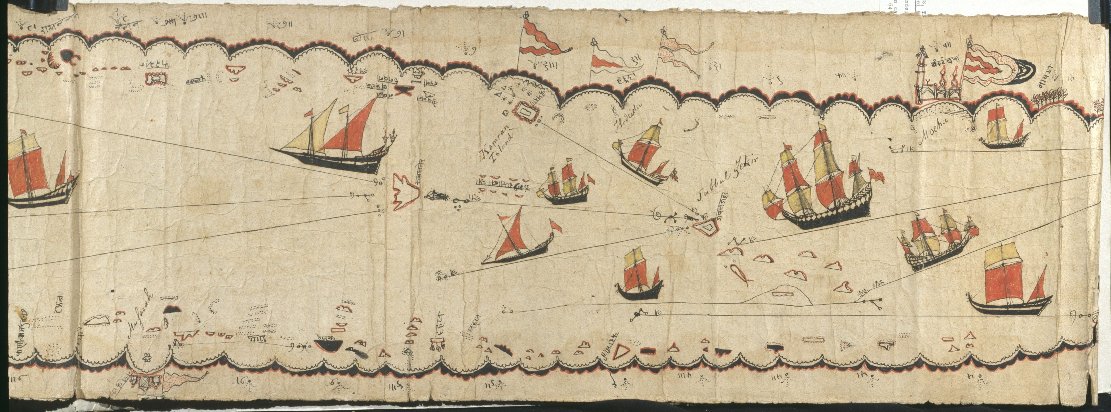
“A native Indian chart of the coast of Arabia and the Red Sea”, mr Asia S.4 (rgs534125)
1
2
3

Slide 3
“Reduced Sketch of a Native Indian chart”, JRGS, Vol. 6, p. 113

Slide 4
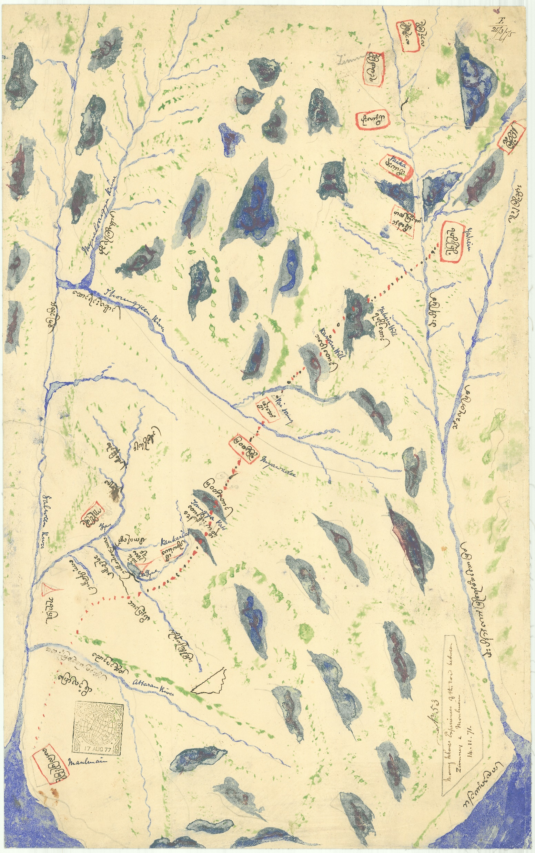
“Native Map in Native characters of part of Lower Salween”, mr Burma S. 31 (rgs534788)

Slide 5
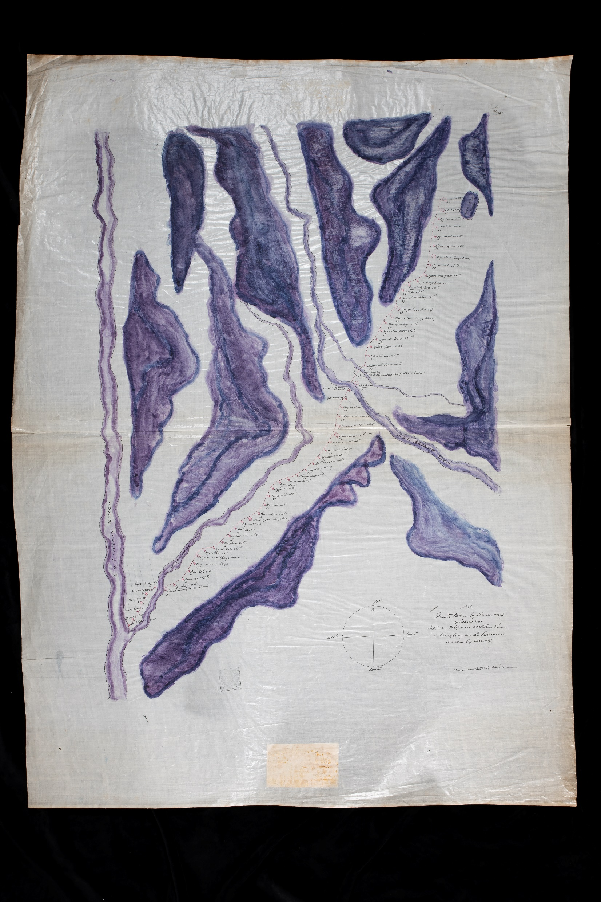
“Route taken by Namawong of Kieng-ma between Talifoo in Western China and Konglong on the Salween”, mr Burma S. 33 (rgs534799)

Slide 6
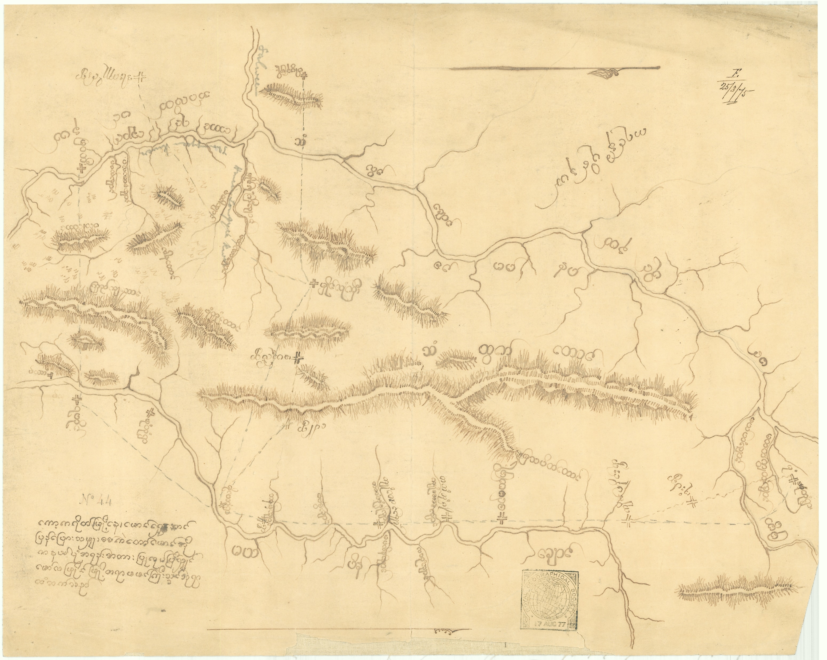
“Native maps of Burma in native characters”, mr Burma S. 39 (rgs534765)

