Slide 1
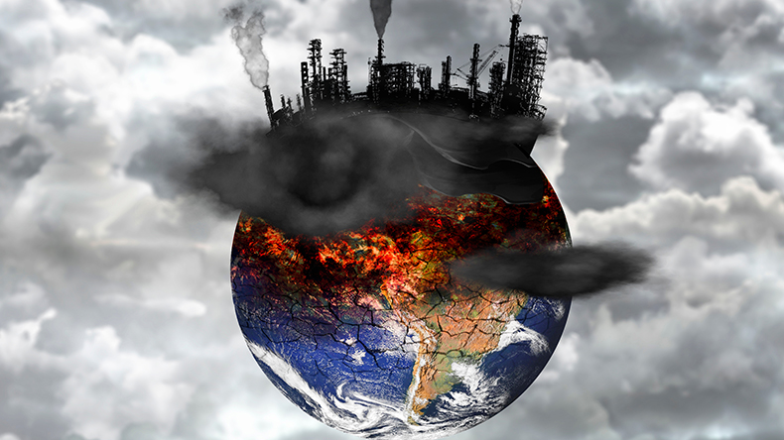
The Global Issues Geographers Face
Learning Objective: To explain the purpose of the Sustainable Development Goals and link them to current global issues.
Starter:
Think - Pair - Share
What problems do you think the world currently faces? Make a list.
Challenge:
Can you categorise these problems?

Slide 2
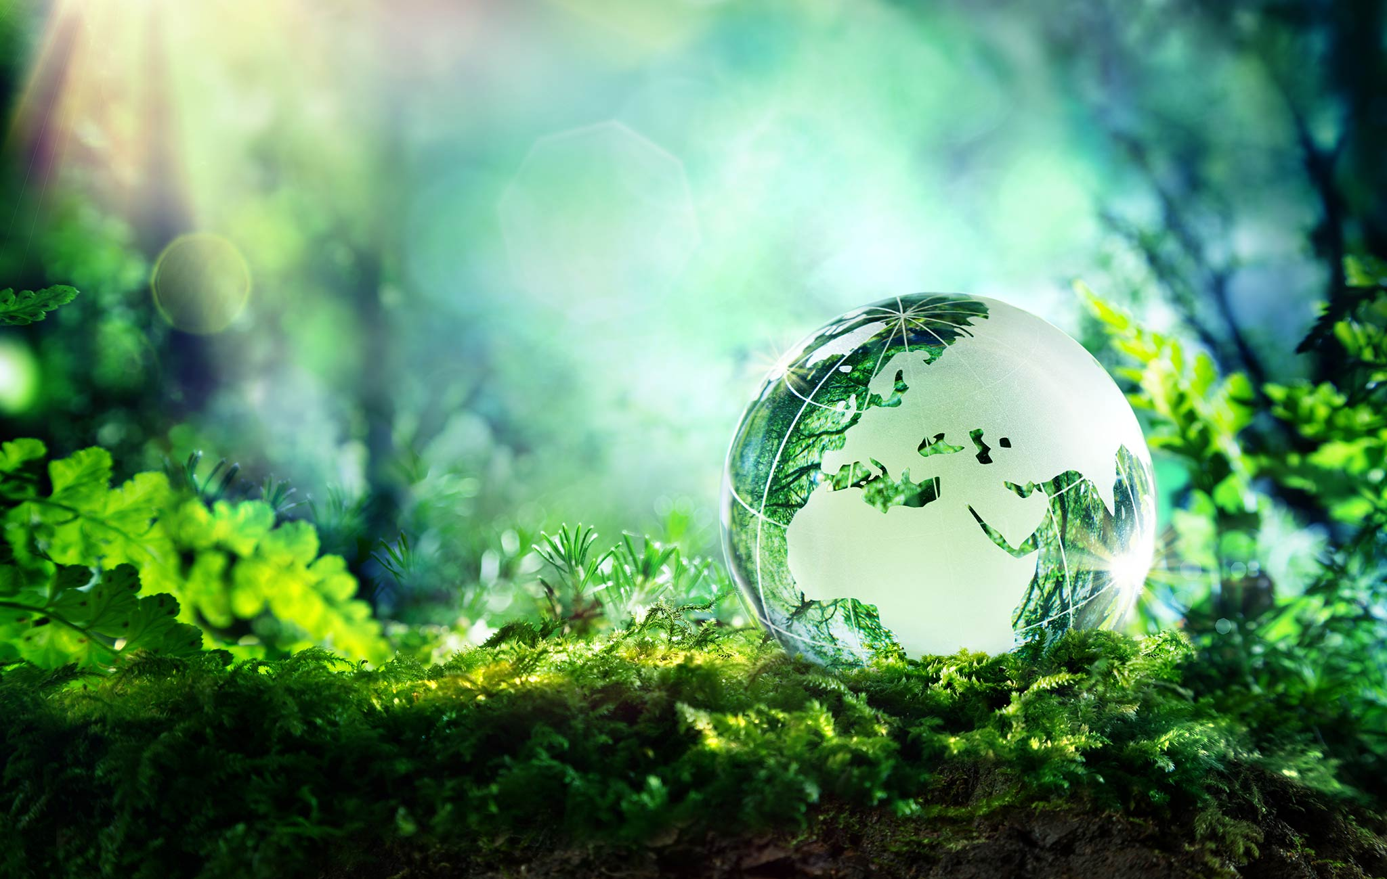
What is sustainability?
Sustainability is “meeting the needs of the present without compromising the ability of future generations to meet their own needs”. - United Nations.
Why do you think an understanding of sustainability is so important now and in the future?

Slide 3
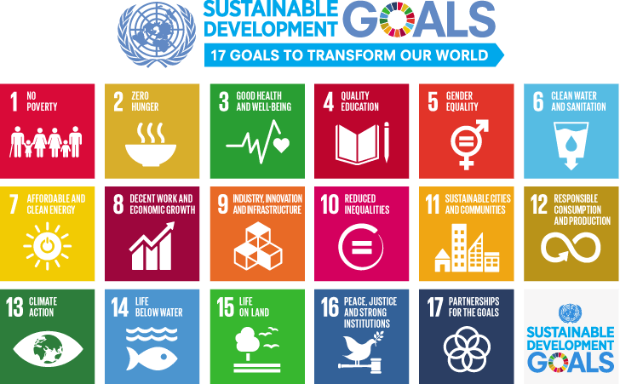
The Sustainable Development Goals (Global Goals) are a ‘call for action’ by all countries to promote global development while protecting the planet for the future.
Task: Based on the SDGs, draw a mind map of the problems you think the world currently faces. Categorise them using STEEP.
Challenge: Explain why you think each problem you have identified exists.
Notes:
STEEP = Social, technological, economic, environmental, political

Slide 4
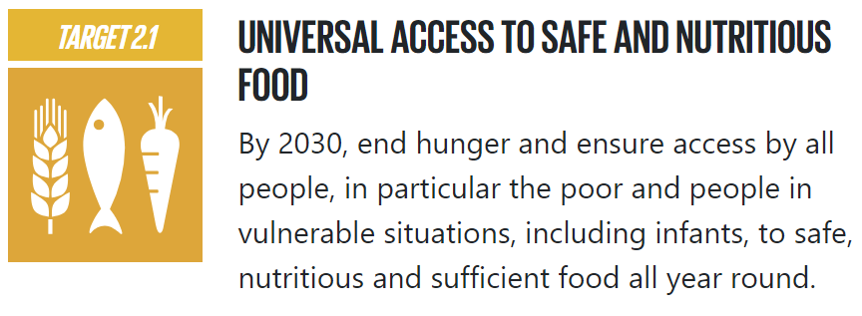
Goal 2: Zero Hunger
Task: Research how Goal 2 has been broken down into smaller targets: https://www.globalgoals.org/goals/2-zero-hunger/
Can you think of any examples of 2.1 being achieved?
e.g. Free school meals by Marcus Rashford
Notes:
https://foodfoundation.org.uk/news/our-free-school-meals-campaign-crowned-best-decade

Slide 5
Goal 2: Zero Hunger
Task: Research some other examples of food security projects. What are the aims of the projects? What kind of strategies are they employing? How much do they cost on average?
https://www.worldbank.org/en/topic/agriculture/brief/food-security-update/our-projects

Slide 6
Plenary
3 - Sustainable Development Goals
2 - ways in which we can categorise issues the world faces
1 - definition of sustainability

Slide 7
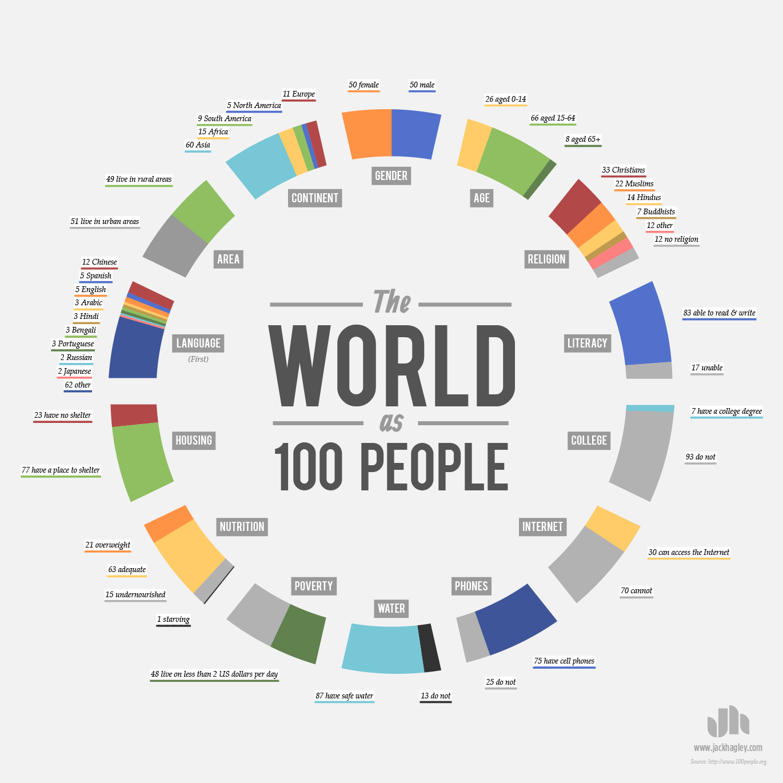
Homework
Consider the world as 100 people.
Using the infographic, choose one statistic that surprised you and explain why.
Choose another statistic, explain what the problem is and briefly propose a solution.

