Slide 1
Weddell Sea Expedition 2019
Image gallery
Weddell Sea
Antarctica
January 2019
The images in this gallery are intended for educational use only

Slide 2
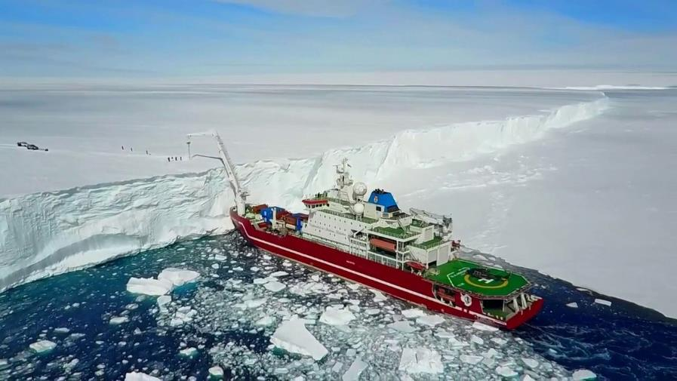
SA Agulhas II ice breaker

Slide 3
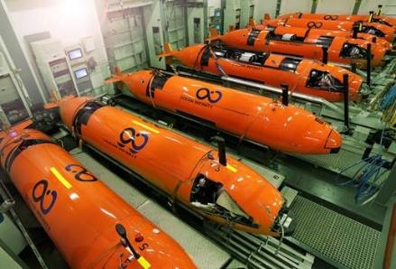
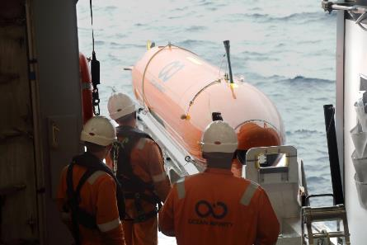
Autonomous Underwater Vehicle (AUV)
Use acoustic positioning to survey the seabed
© Ocean Infinity

Slide 4
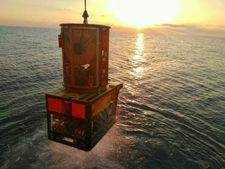
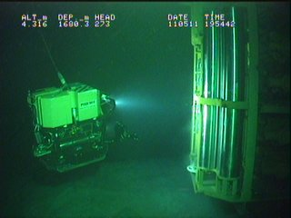
Remotely Operated Vehicle (ROV)
Used to location and position subsea structures
© Eclipse Group

Slide 5
Sediment corer
Box corer used to collect sediment from the sea floor

Slide 6
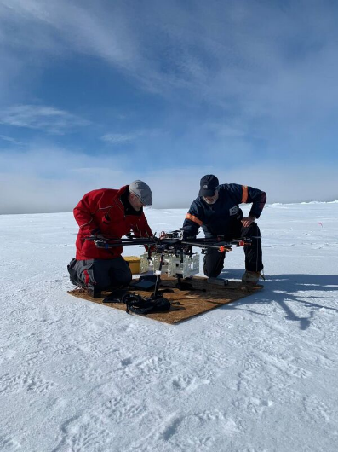
Drone
Drone used as a navigation tool and to capture images
© Reach the World

Slide 7
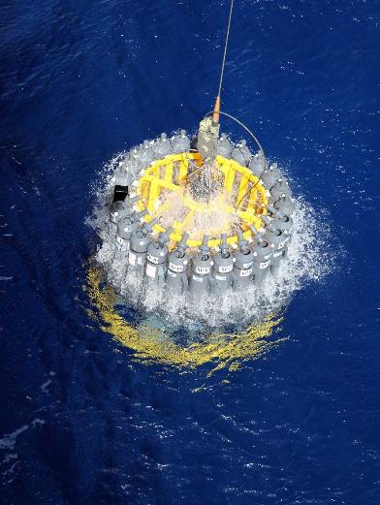
CTD water sampler
Used to measure the conductivity, temperature, and pressure of seawater

Slide 8
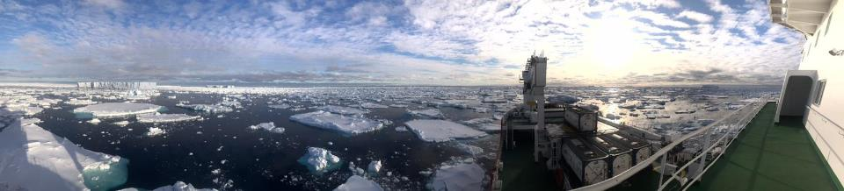
View from SA Agulhas II January 2019

Slide 9
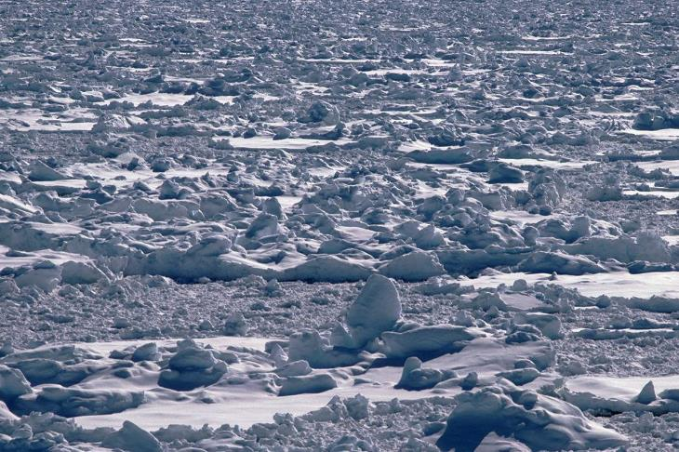
Sea ice in the Weddell Sea

Slide 10
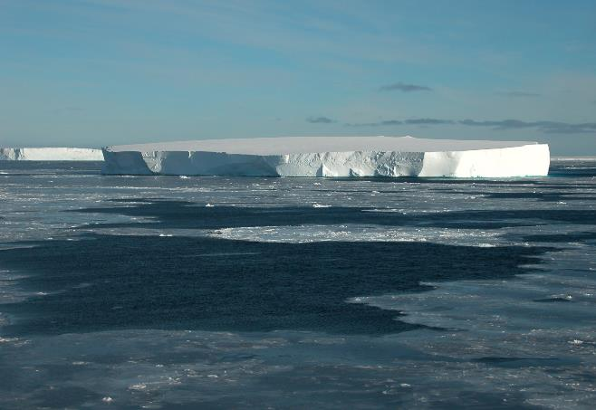
Tabular iceberg
© Julian Dowdeswell

Slide 11
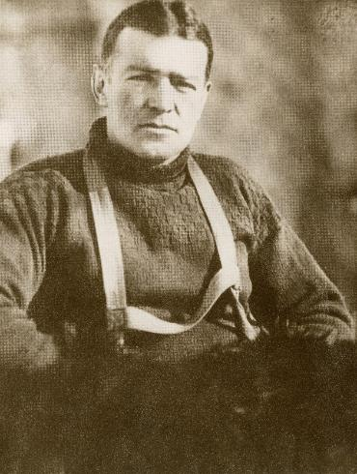
Sir Ernest Shackleton
© RGS-IBG

Slide 12
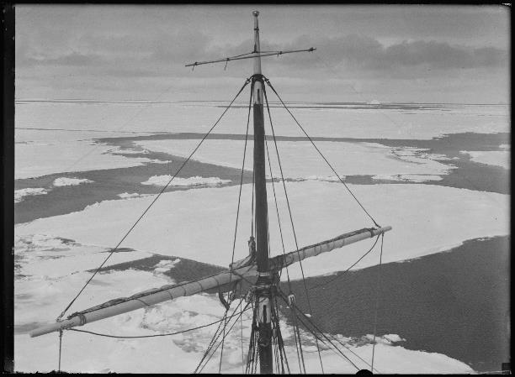
Endurance enters pack ice
© RGS-IBG

Slide 13
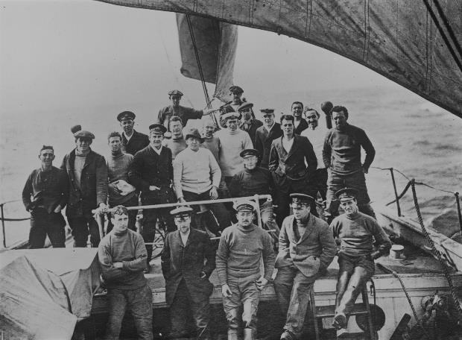
The crew of the Endurance
© RGS-IBG

Slide 14
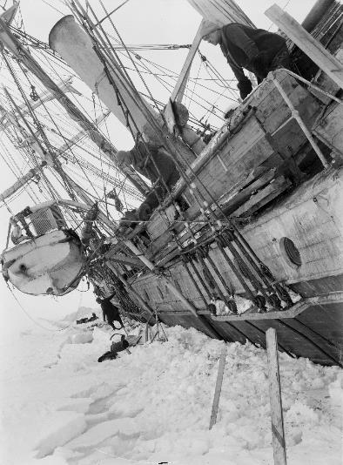
Shackleton leaning over the side of Endurance
© RGS-IBG

Slide 15
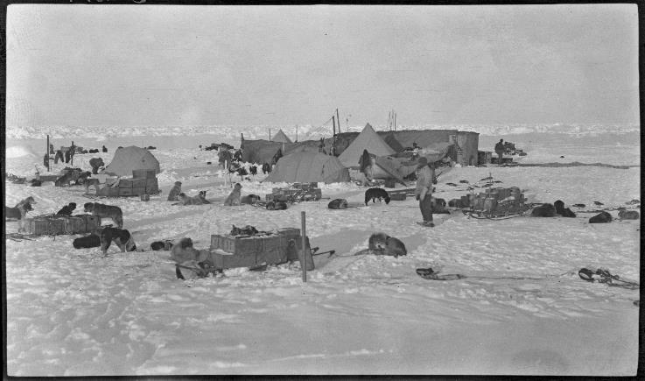
Ocean Camp
© RGS-IBG

Slide 16
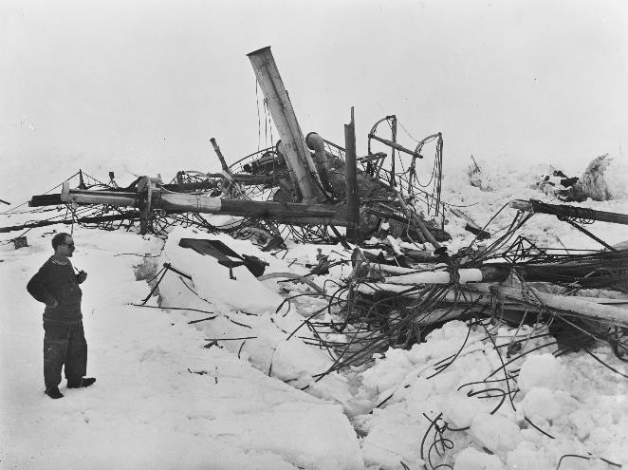
Frank Wild looks at the wreck of Endurance Endurance
© RGS-IBG

Slide 17
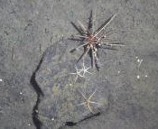
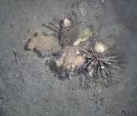
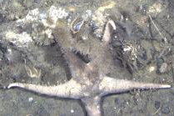
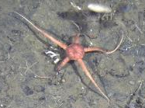
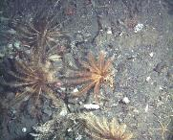
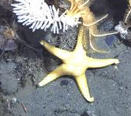
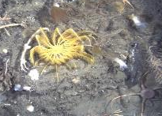
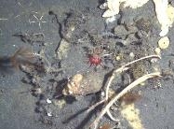
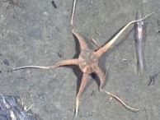
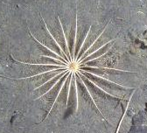
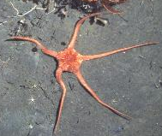
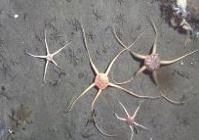
Deep sea biology in Antarctica
© BAS/JR17003a

Slide 18
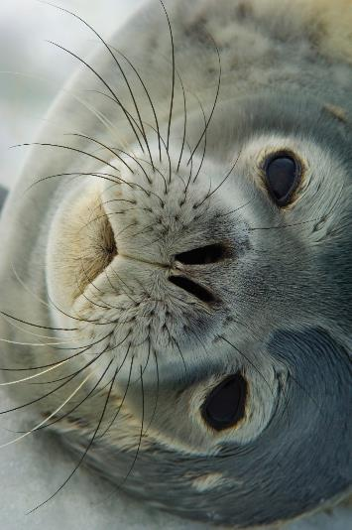
Weddell Seal
© BAS/10009893

Slide 19
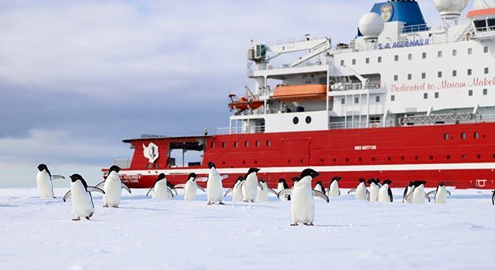
A visit from the locals
© Claire Grogan January 2019

Slide 20
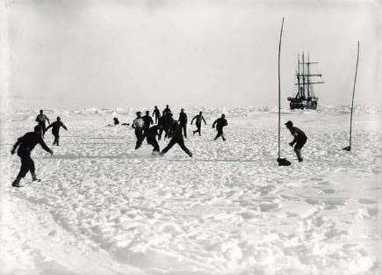
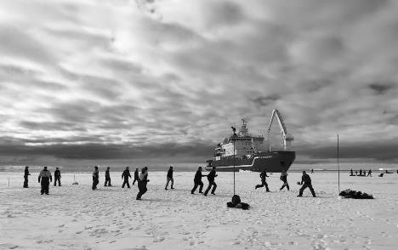
Football on ice
1915
2019
© Weddell Sea Expedition

Slide 21
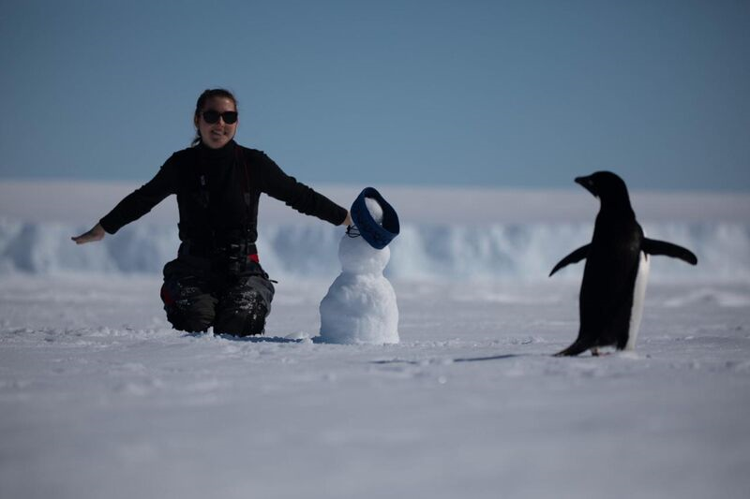
Communicating with the local wildlife
© Reach the World

Slide 22
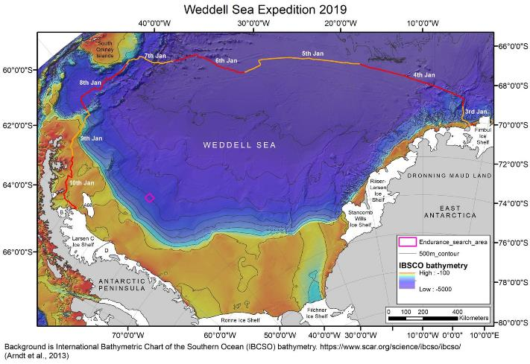
Route of the WSE January 2019
© Weddell Sea Expedition

Slide 23
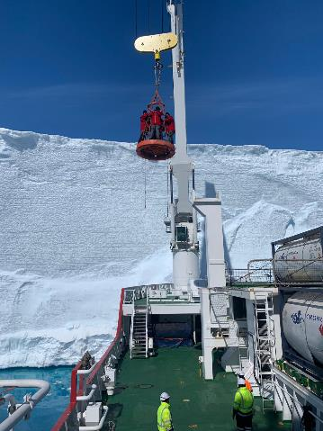
Catching a ride to the ice shelf
© Reach the World

Slide 24
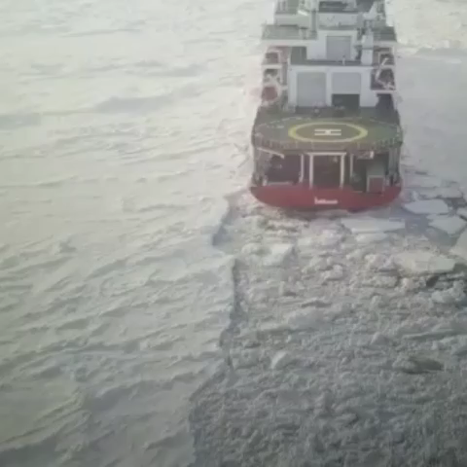
Weddell Sea conditions
© Weddell Sea Expedition 2019

