Slide 1
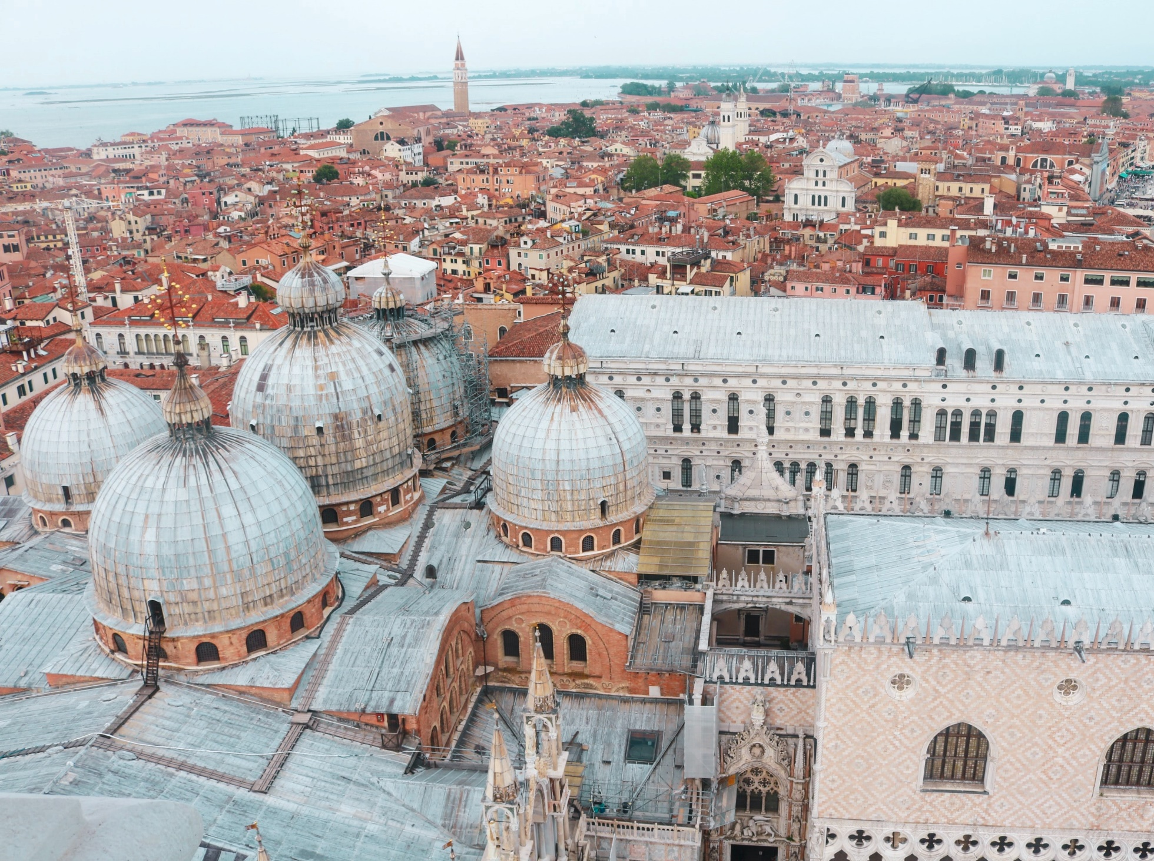
Venice as a changing place: governance and economy
lesson 4: part 1 the different levels of governance in Venice
© Anna Church

Slide 2
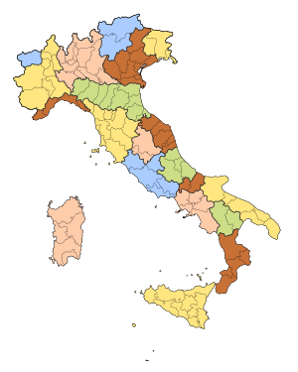
The political structure
Italy is composed of 20 regions which each have a degree of autonomy and political power over their own affairs.
Each region has a governor or president and an elected body called the Consiglio Regionale.
Venice is located within the Veneto region, and is also its capital city.
The area of the Veneto generally corresponds with the region that was historically controlled by the independent Republic of Venice until 1797 (Napoleonic Wars). It became a region of a united Italy in 1866.
Veneto
Veneto flag
By Derivative work: F l a n k e r & Angelus (talk) - Own work based on: Flag of Veneto.png, CC BY-SA 3.0, https://commons.wikimedia.org/w/index.php?curid=10015105

Slide 3
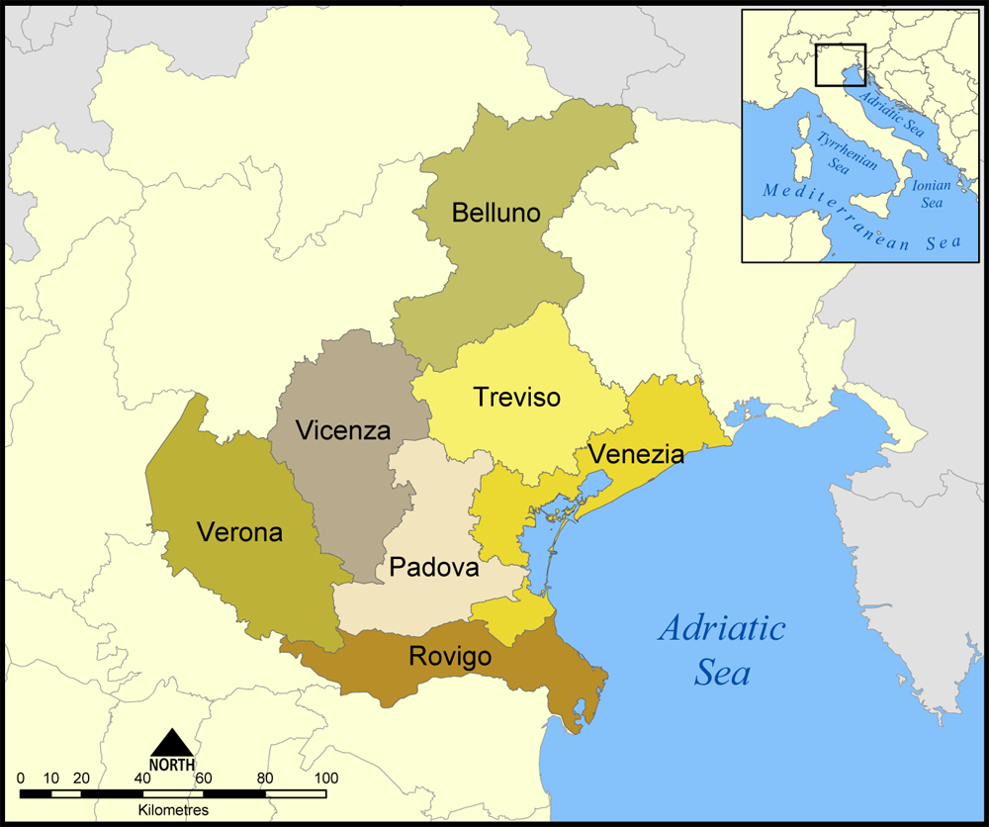
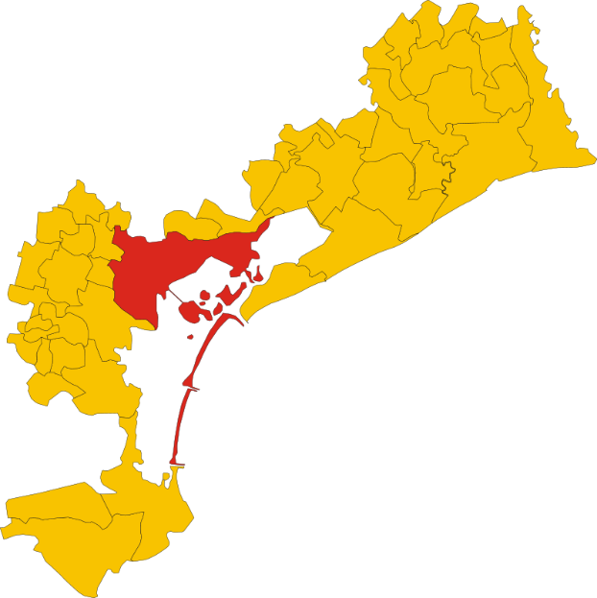
The Veneto contains six provinces and the Metropolitan City of Venice
Metropolitan City of Venice
Comune of
Venice in red
By Vonvikken - Own work, Public Domain, https://commons.wikimedia.org/w/index.php?curid=15171778
CC BY-SA 3.0, https://commons.wikimedia.org/w/index.php?curid=303866
The Republic of Venice existed as an independent state for over 1000 years until 1797, and this accounts for the strong and distinctive regional identity of the Veneto that still exists today. The website below offers a summary of some of the physical and social factors behind the historical success of Venice.
https://veneziaautentica.com/history-of-republic-of-venice/

Slide 4
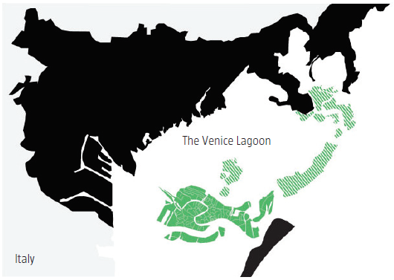
The Metropolitan City of Venice is composed of 44 separate municipalities (comuni), one of which is the Comune of Venice.
The Comune of Venice includes the historic city, the mainland, and the islands of the lagoon. The mainland was made part of the comune in 1926.
The Comune of Venice has a
population of about 260,000,
of which only about 53,000
are permanent residents of the
historic city.
Recent demographic trends
are the focus of lesson 1.
Source: The Venice Report 2009

Slide 5
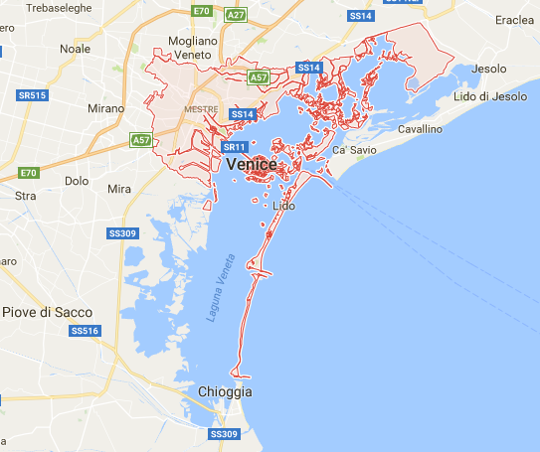
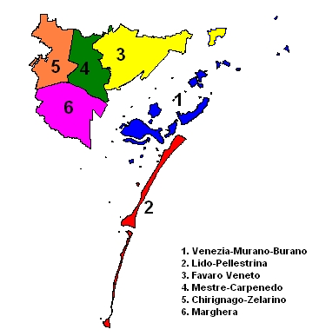
The Comune of Venice contains six boroughs (municipalità)
Image from Google Maps
By it:user:Frassionsistematiche - http://it.wikipedia.org/wiki/File:Municipalit%C3%A0.PNG, Public Domain, https://commons.wikimedia.org/w/index.php?curid=6837704
Each borough has its own consiglio and some autonomy over its local budget.

Slide 6
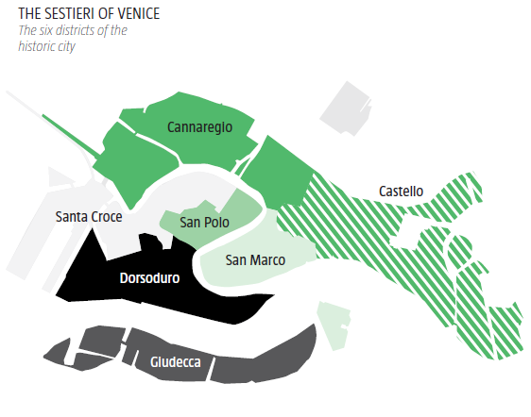
The historic city is composed of six districts called sestieri. These districts are not units of government, but remain useful units for historic city statistics.
Rialto Bridge
Grand Canal
Source: The Venice Report 2009

Slide 7
Other aspects of governance
Five levels of governance affect the historic city.
National, regional, provincial, municipal (comuni), borough (municipalità)
Other public bodies, such as the Venice Water Authority and the North Adriatic Sea Port Authority also exercise certain powers and privileges.
At the regional level, the Veneto has had conservative majorities, whereas the Comune of Venice has more often been under the control of centre left parties.
In a century, there has been a major population shift from the historic city and other lagoon islands to the mainland.
With this change has been a shift in political power.
The interests of mainlanders can sometimes be at odds with the interests of those who live in the historic city and other islands.
International organisations also have a stake and an influence on the city.
Venice and its lagoon constitute a UNESCO World Heritage Site.
This link includes detail on the Venice world heritage site management plan: https://whc.unesco.org/en/list/394
Key ideas: There are multiple stakeholders with different interests. Different stakeholders have more or less political influence at different levels of government. With five levels of governance, establishing lines of responsibility and coordinating action is challenging.

Slide 8
Other aspects of governance
There is a Special Law for Venice dating from 1973 which makes protection of Venice and its lagoon a national concern.
The website below gives more information about this: http://www.veniceproject.com/index.php/en/governance/special-law-for-venice
Despite the Special Law for Venice and the money invested since the 1970s (largely in response to the devastating floods of 1966 to repair the city), many of the historic city’s problems remain unsolved.
If UNESCO were to add Venice to its list of ‘world heritage in danger’, many believe this could galvanize efforts to protect the city and to promote more coordinated action. See the article below for further detail.
https://www.theartnewspaper.com/comment/venice-is-in-peril-unesco-should-come-to-the-aid-of-venice-as-it-did-after-the-great-flood-of-1966

