Slide 1
Nimr Reed Beds
What do you think wetlands are?
Learning Goals
To Know what wetlands are.
To Describe the location of the Nimr Reed Beds.
Understand how wetlands like the Nimr Reed Beds help clean water.
How do you think wetlands help people and the environment?

Slide 2
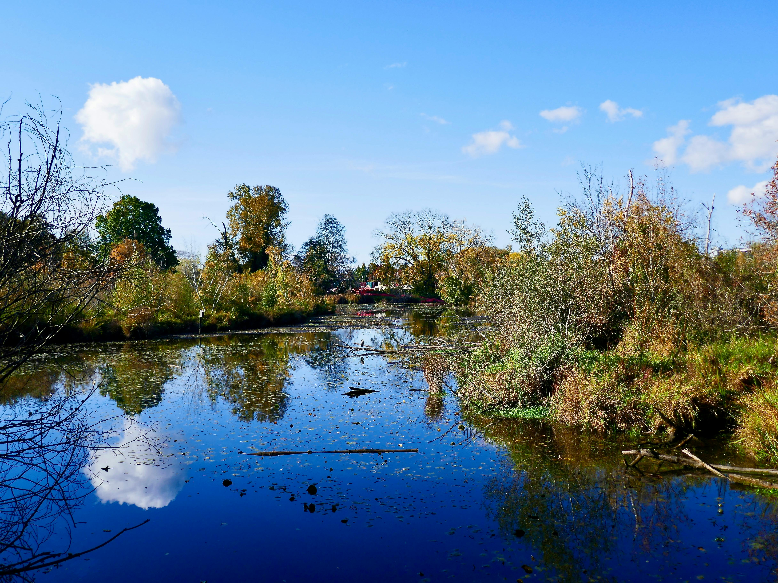
What are wetlands?
They are places where the land is covered in water but also have vegetation.
The water can be permanent or seasonal.
They are nature’s wastewater treatment plants.
They cover around 3% of the planet but store 30% of all land-based carbon. That’s double of all the world’s forests together!
Image of a wetland © Utsukushii, Pexels
Notes:
Teacher’s Notes
If you want to have more information on wetlands, the WWF have a good webpage dedicated to them: https://www.worldwildlife.org/stories/what-is-a-wetland-and-8-other-wetland-facts

Slide 3
Nimr Reed Beds
Add some facts about the Nimr Reed Beds to your fact sheet.
The Nimr Reed Beds are an example of a wetland, but they have been made by humans rather than nature.
They have been planted to help clean water used in the production of oil.
It is the world’s largest human-made wetland.
It is now its own ecosystem becoming a habitat for over 130 species of birds, fish and wildlife.
¾ of the water filtered is reused.
Look closely at where the Nimr Reed Beds are on the map.
Describe the location on your fact sheet. Remember to use compass points in your answer.

Slide 4
Create your own wetland
In groups or pairs, follow the instructions on the mini wetlands experiment sheet to create your own wetlands.
Summarise your findings on your fact sheet.
Notes:
Teacher Notes:
If you wanted to make a larger scale wetland for your school, the National Garden Scheme with WWT has some good ideas here: https://ngs.org.uk/app/uploads/2024/01/How-to-make-a-mini-wetland-guide_NGS.pdf

Slide 5
What do you now know about wetlands?
Add what you know now about wetlands to your fact sheet thinking specifically about how wetlands help people and the environment.

