Slide 1
Introduction to Wādī Darbāt and Khor Ruri
Find the definition to your image or image to definition.
Learning Goals
Locate Wādī Darbāt and Khor Ruri on a map.
Identify some of the main features of Wādī Darbāt and Khor Ruri to understand what the place is like.
Think of ways in which places like Khor Ruri are important for people and the environment

Slide 2
It’s a puzzle
In your pairs, put the puzzle pieces together.
What do you think the finished image showing you?
Draw your own copy of the map in your books.
Can you describe the location of this place?
Words to help you describe a location
(north/south/east/west) of (place / landmark)
near/far

Slide 3
What do the Wādī Darbāt waterfalls and Khor Ruri look like?
Watch this video on how you draw a fieldsketch.
Now, taking the image you have been given, follow the video instructions to draw your own field sketch of the Wādī Darbāt waterfalls or Khor Ruri.
Use some of the words in the box below to help you with your labels.
Challenge: can you develop the labels further by adding descriptions?

Slide 4
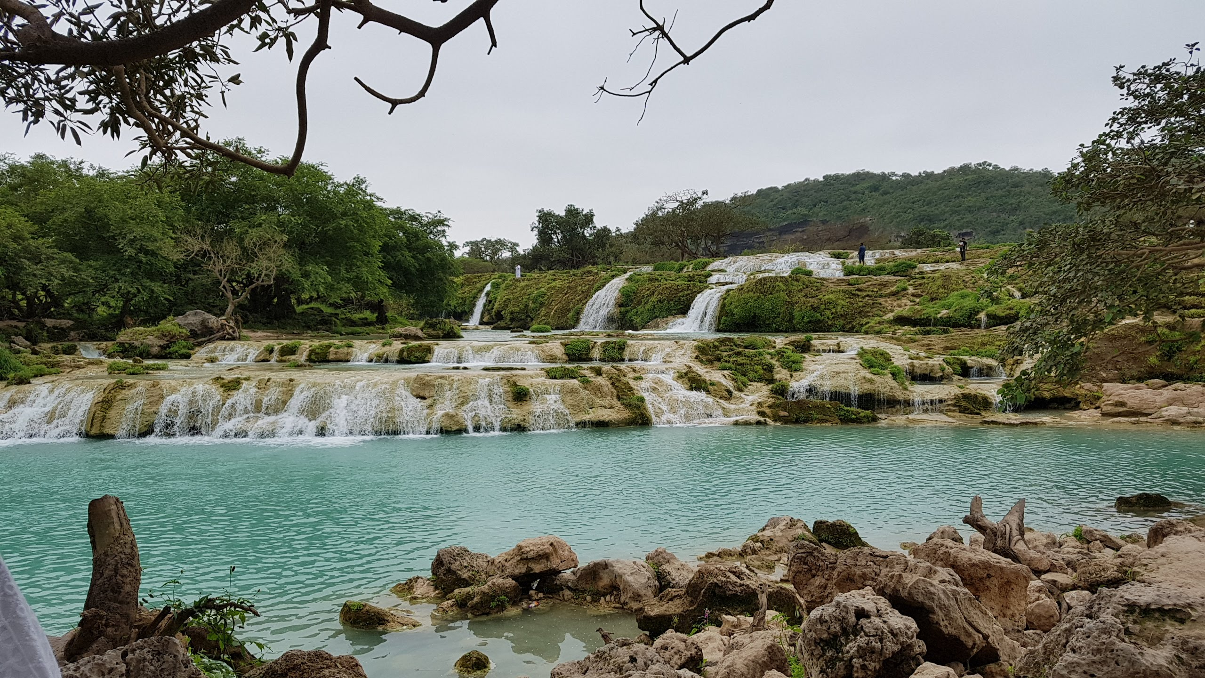
The Wādī Darbāt waterfalls © Wikimedia

Slide 5
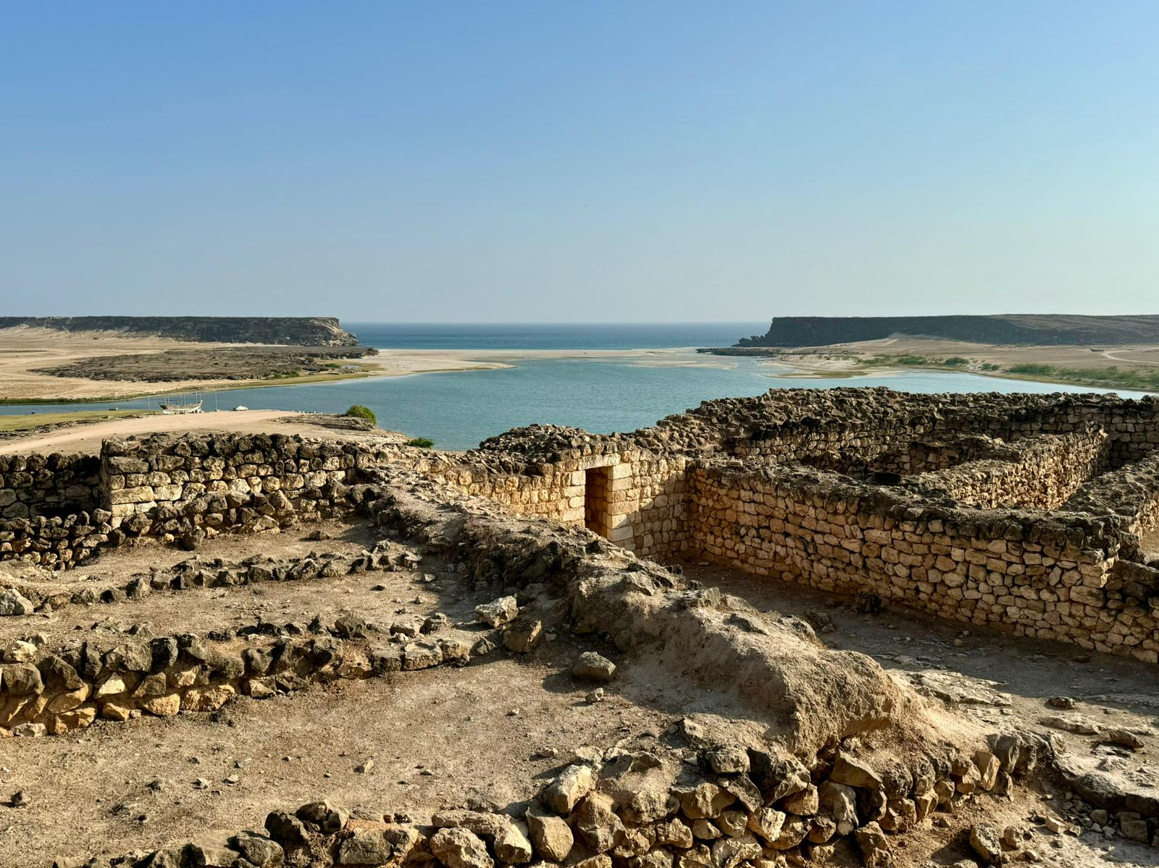
Khor Ruri © Ana-Maria Pavalach

