Slide 1
Making case studies stick!
Fiona Old
Subject Leader for Geography
Kingsthorpe College
@fiona_616

Slide 2
Simple ideas we have used to help us to improve student case study knowledge.
Copies of resources available from my Google Drive.

Slide 3
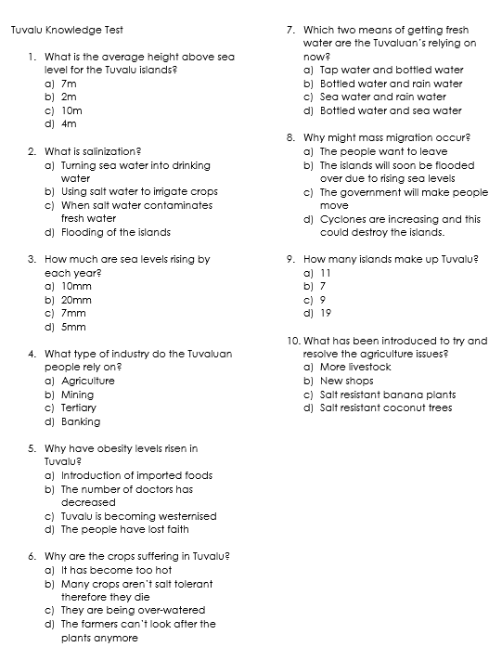
Regular quizzing
10 multiple choice questions.
Used at the beginning of end of lessons.
Often we use older case studies from different topics to aid retention.
Focus on specific facts and data.
Also added to Teams so that students can complete self-marking quizzes. This enables us to be forensic and see what students are forgetting – this can then be revisited at a later date.

Slide 4
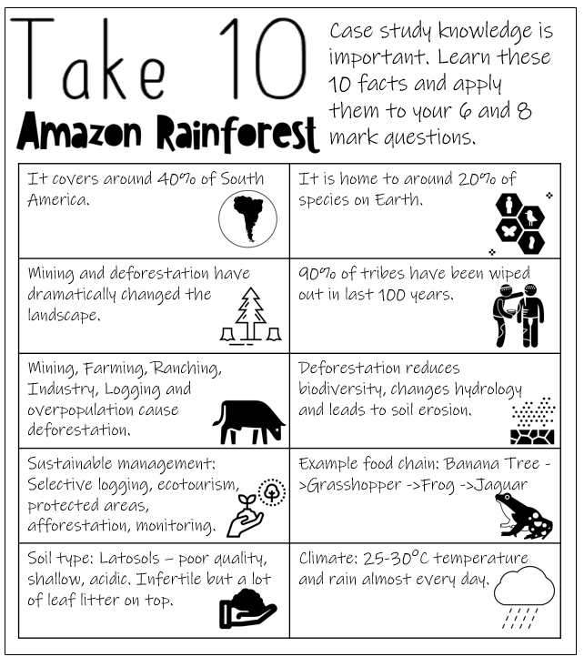
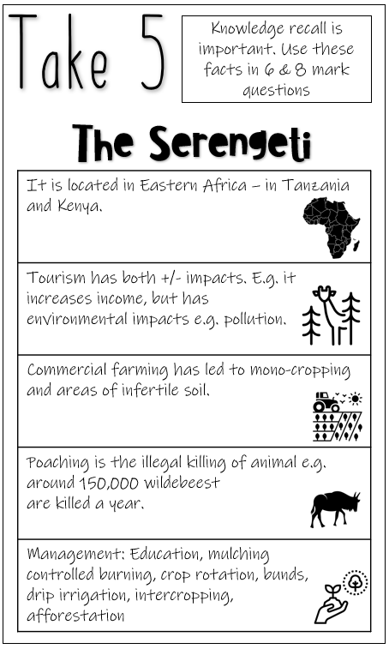
Take 10/5
Take 10 inspiration: @missgeog92
Some knowledge organisers can be a bit overwhelming for students.
We have broken down case studies into 10/5 key points.
Students revise these key points and expect to be tested on them.
Pictures act a hook to help students remember the key facts.
Notes:
Although we give these sheets to students we aren’t limiting their knowledge.
Students also have access to full case studies with a larger number of facts, synoptic links etc.

Slide 5
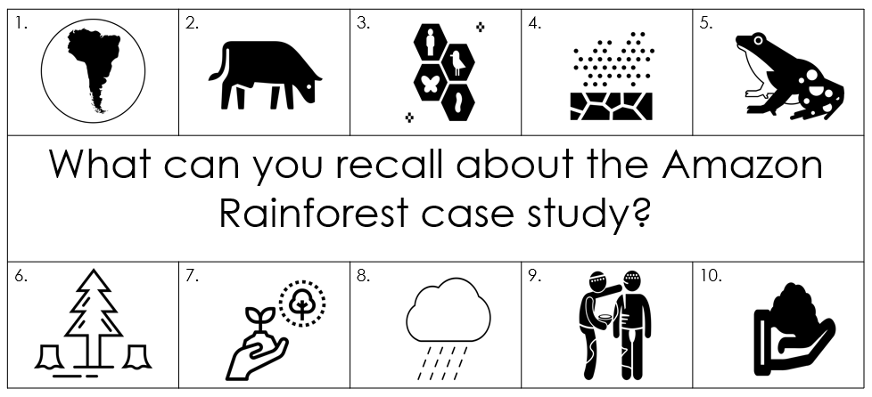
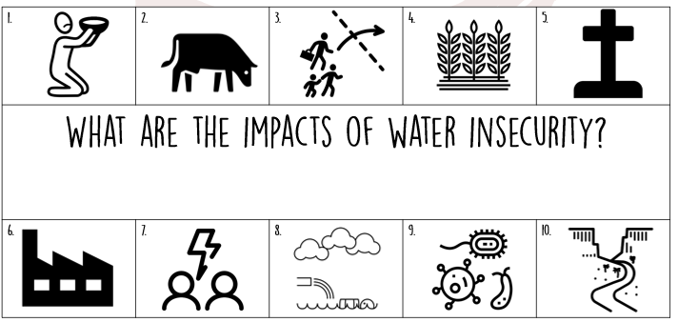
Recall Starters
Using the take 10 sheets students will recall key facts from case studies just using the images.
As a class we will then recall the key facts.
Anything that students miss will be added in a different colour.
This is repeated throughout the year – with interleaved case studies.
Take 10 inspiration: @missgeog92

Slide 6
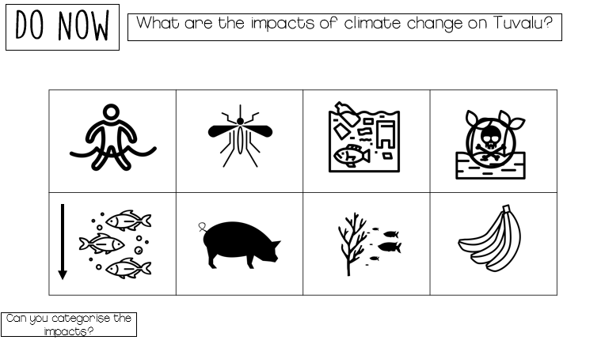
Recall starters
When we look at impacts we often start the next lesson with a recall of the impacts.
Students will then need to categorise the impacts.
Students can then make further links between the impacts.

Slide 7
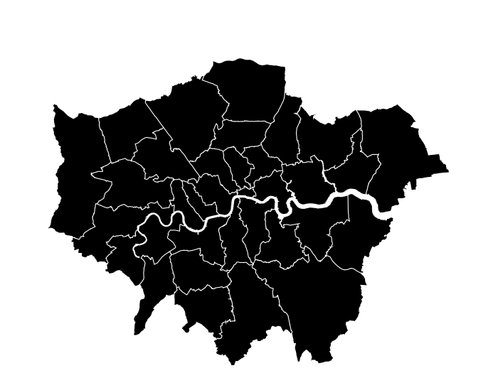
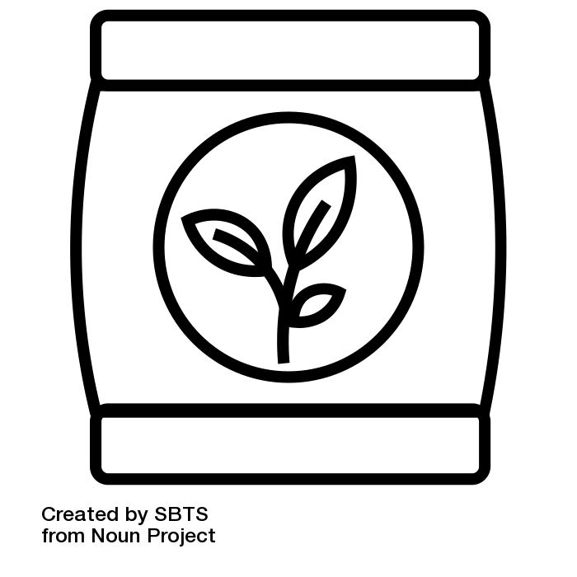
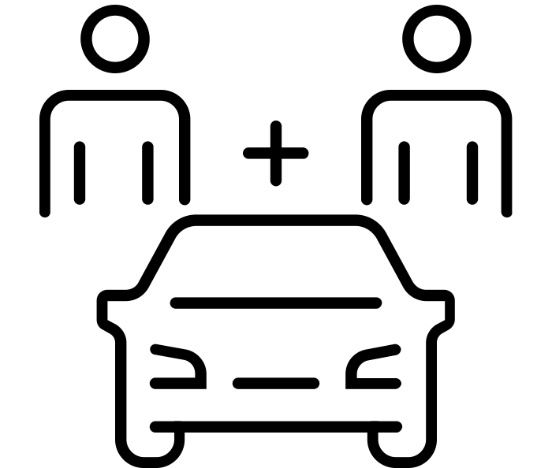
Take 10 knowledge quizzes
What does BedZED stand for? | How many homes were built between 2000-2002. | How much of their waste is composted? | How much less electricity is used? | What are residents encouraged to do?
What is burned to provide heating and electricity? | Which direction do the houses face? | What energy sources are used? | It was the first… | Where is BedZED?
Alternatively we will ask questions using the Take 10 grids.
Students recall key facts using the questions as a prompt.
Students will also be given blank versions of these in revision guides.

Slide 8
Identifying what we would use the case study for.
Once we have covered a number of case studies we will revisit how we would use those case studies and what we should be looking for in exam questions.

Slide 9
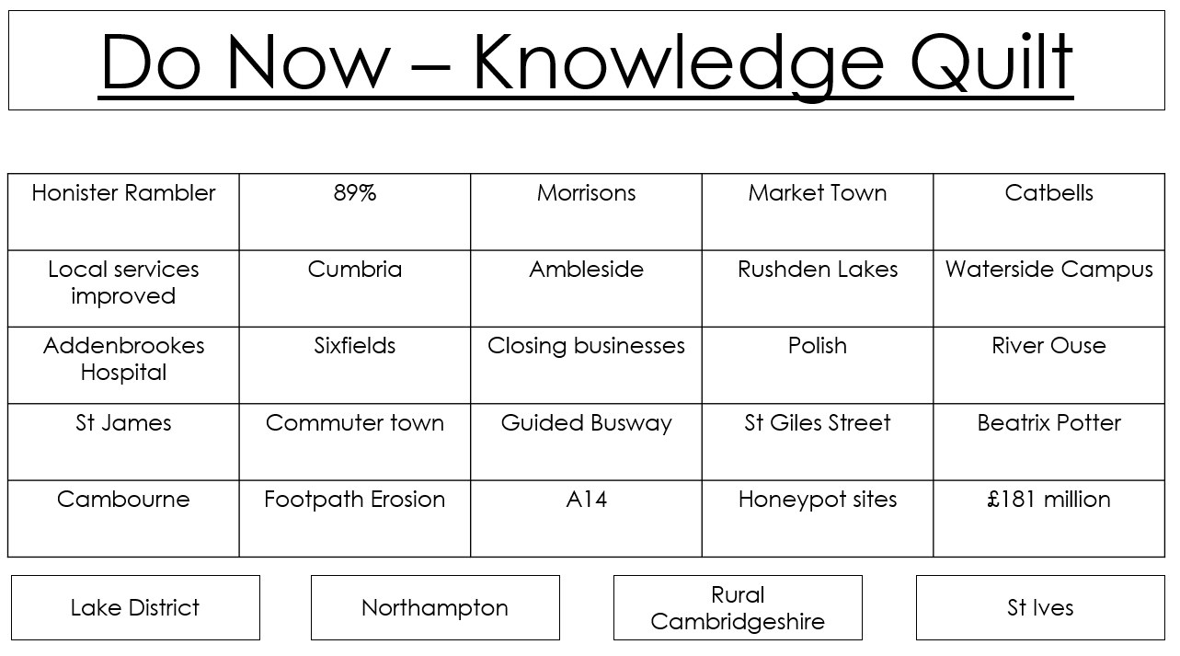
Knowledge Quilts
A combination of different case study facts are put together into a table and students need to categorise which location they belong to.
This really tests their factual knowledge as they have no context for each case study provided.
Sometimes we don’t give the names of the 4 case studies at the bottom of the page – students need to tell us which case studies we have jumbled.
Inspiration: @KKNTeachLearn

Slide 10
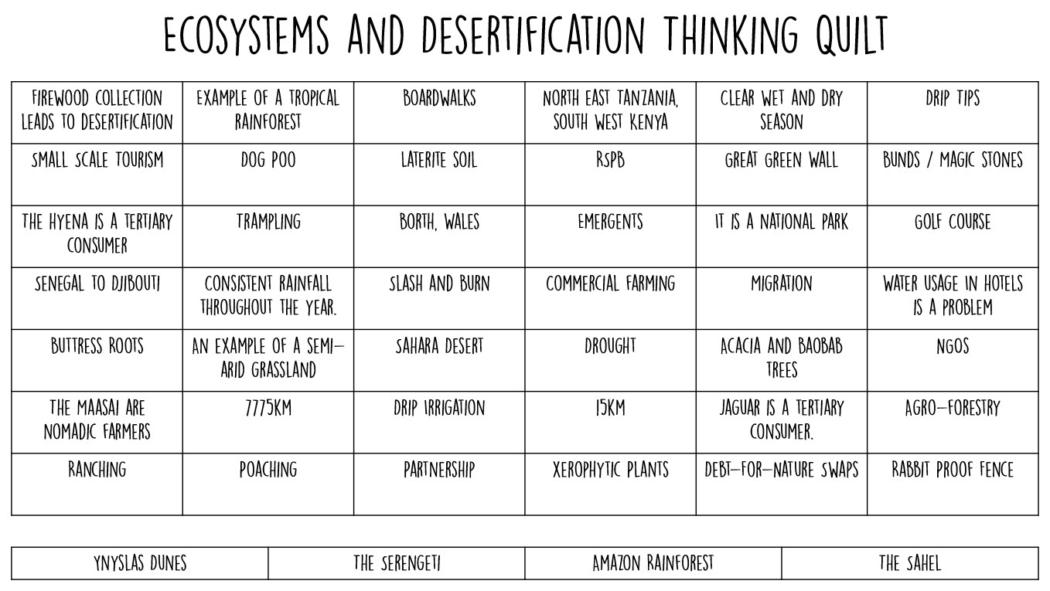

Slide 11
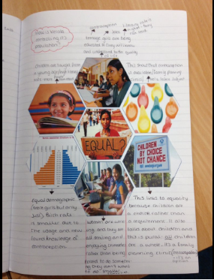
Hexagons
Using imagery from the case studies we put together hexagons for students to summarise the key parts of case studies.
Additional questions are usually given so that students can explore the links between the different parts of the case studies e.g. impacts and responses.
Inspiration:@MrsHumanities

Slide 12
What impact has this policy had?
1.
Stick the hexagons into the centre of your book.
Write down what you can see in each picture – how does this relate to the One Child Policy.
What is the link between pictures 6 and 7?
What is the link between pictures 3 and 5?
What impact did picture 1 have?
When and why did families have their money cut?
6.
2.
7.
3.
5.
4.
Inspiration:@MrsHumanities

Slide 13
Memory Geoggers
5 quick questions at the beginning of a lesson. I usually allow students to work in pairs to ‘geog’ each other’s memory!
Questions could come from one topic or from multiple topics.
Works well to interleave knowledge.
This can be extended to include links to the current topic.
Inspiration:@Jennnnnn_x

Slide 14
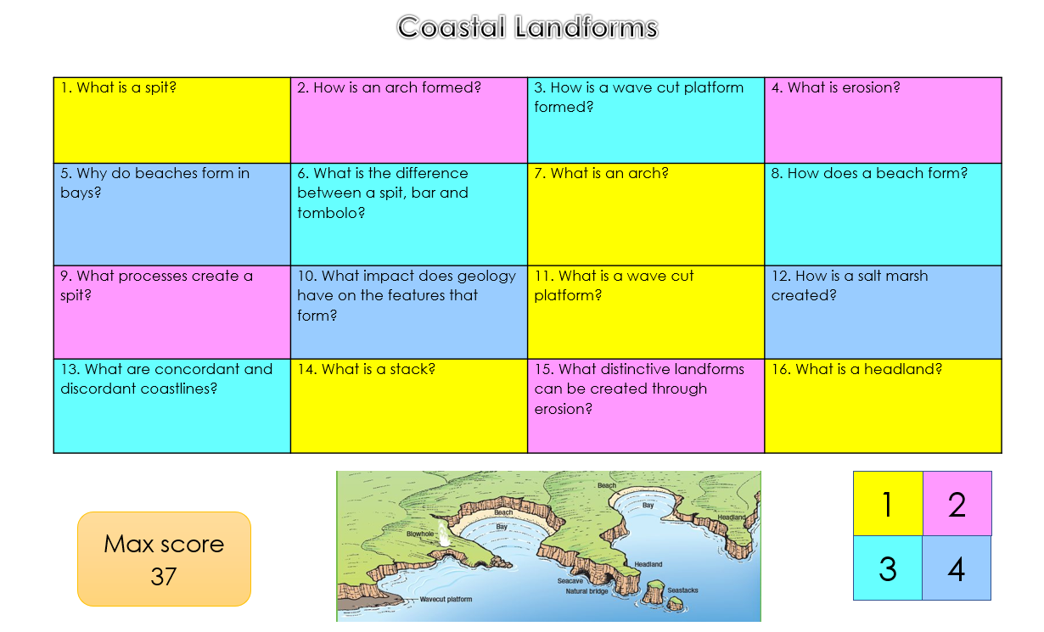
Challenge Grids
Great way to quiz students a the end of a case study.
Could be used a competition – highest score wins – students could work together to complete the grid.
Questions are of differing difficulties.
Command words could also be used to provide exam format familiarity.
Inspiration:@MsLiddell @Jennnnnn_x

Slide 15
Other ideas that we have used
Case study bingo at the end of lesson. A list of information from the case study is given, students choose 9 pieces to put into a 3x3 grid. Teacher makes statements linked to the information e.g. number of collapsed buildings, name of the river etc. Students cross them off as they hear them.
Fake tweets/facebook statuses – find and fix style – spot errors in the reporting.
WAGOLL/WABOLL 8 markers using case studies. Find and fix any errors. See how much case study knowledge is used when answering questions.
Reference the different locations that we study as much as possible. Have a map with the different locations on in a prominent spot.

