Slide 1


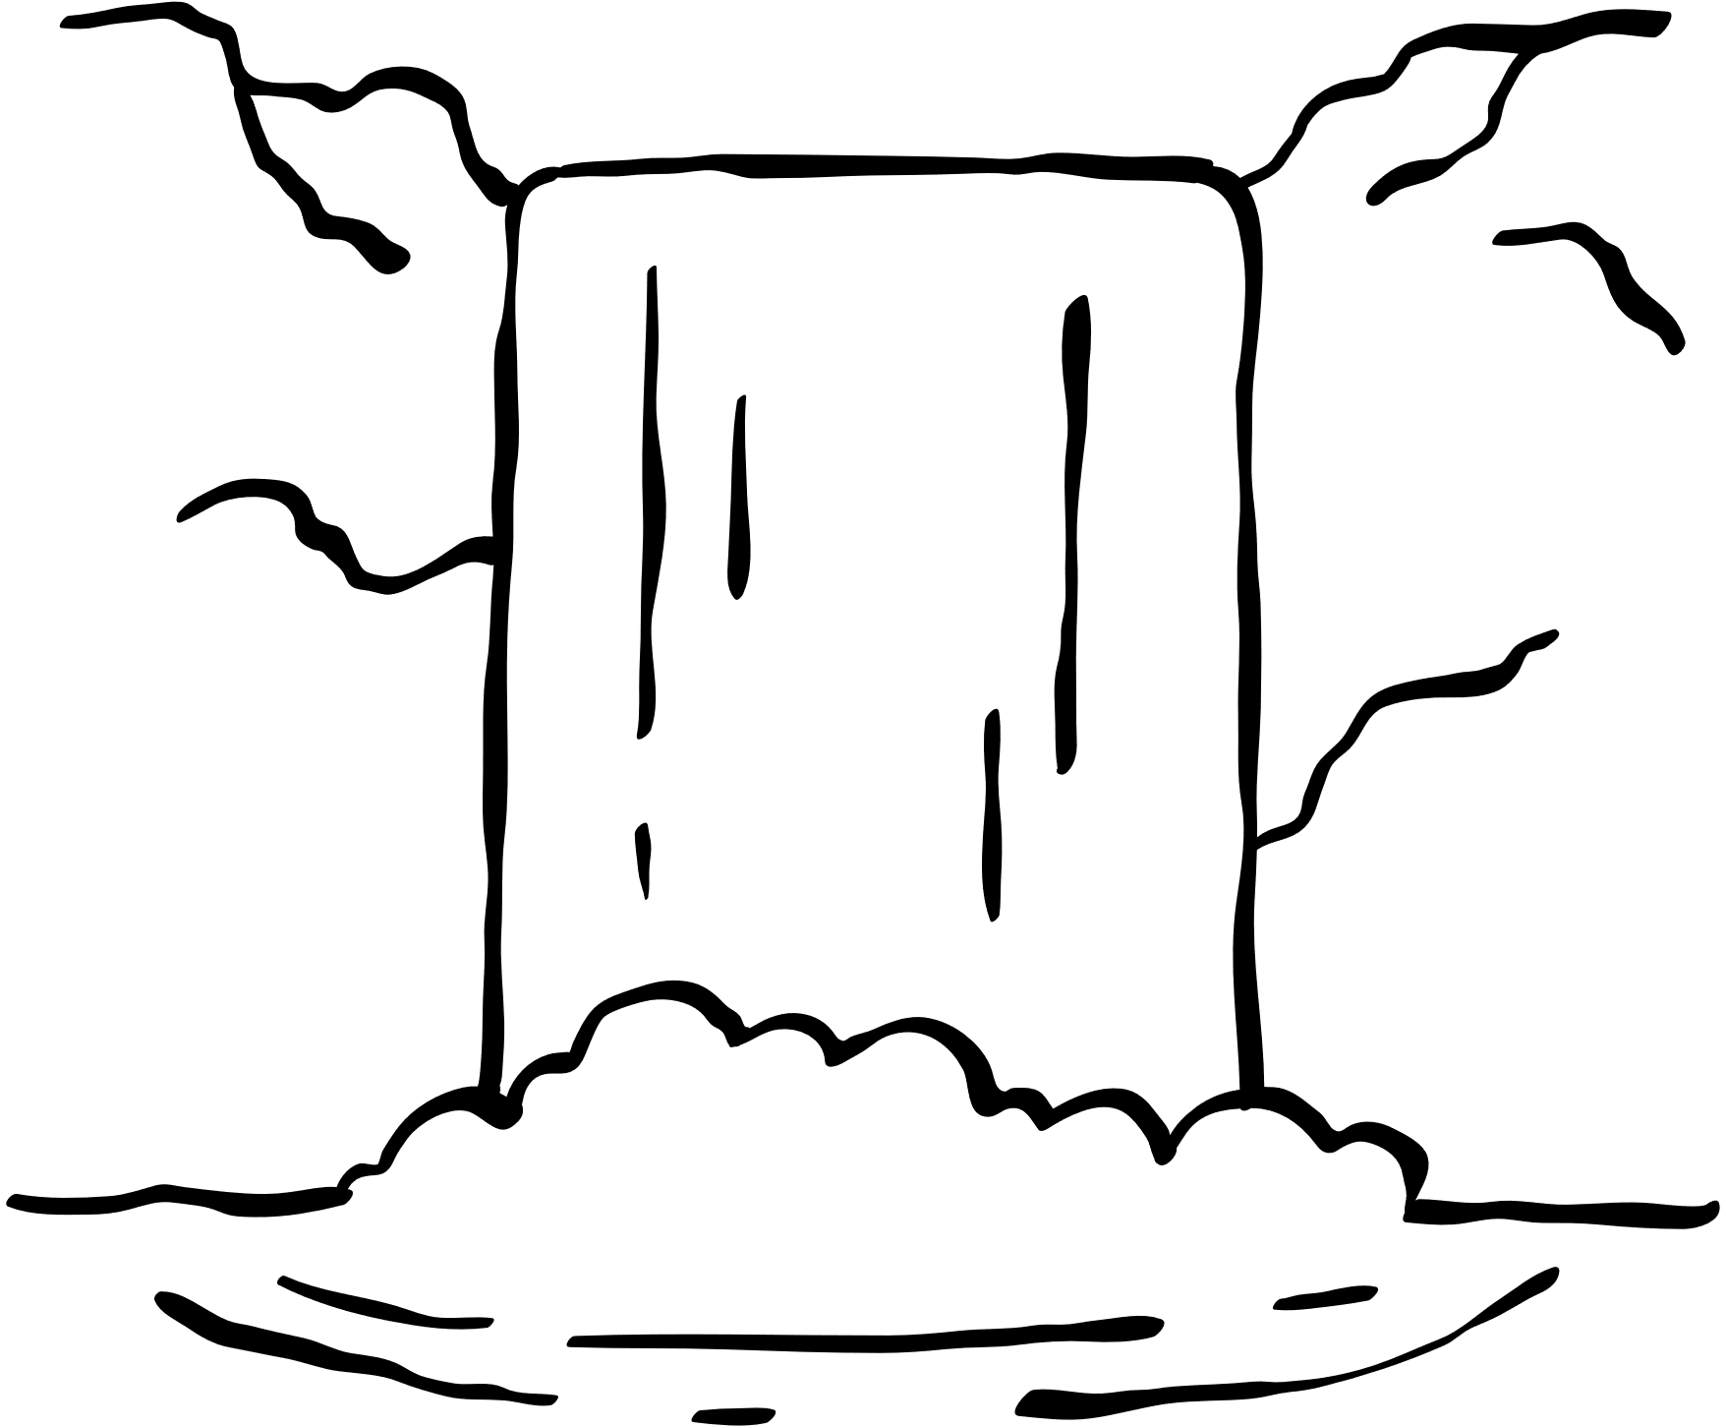
Formation of a waterfall
1
A river flows over the ground moving downhill.
2
The river flows over hard and soft rock. Soft rock is easier to wear away than hard rock.
4
As the water falls over the step, it hits the bottom very hard making a hole called a plunge pool.
3
The soft rock wears away leaving a step in the river.
6
5
Overtime, the overhang gets too heavy and breaks off into the plunge pool. The waterfall moves backwards and the process starts again.
The hard rock left behind stick out over the soft rock called an overhang.

Slide 2

Overhang
A waterfall is seen through a cave © Miguel Cuenca, Pexels

Slide 3
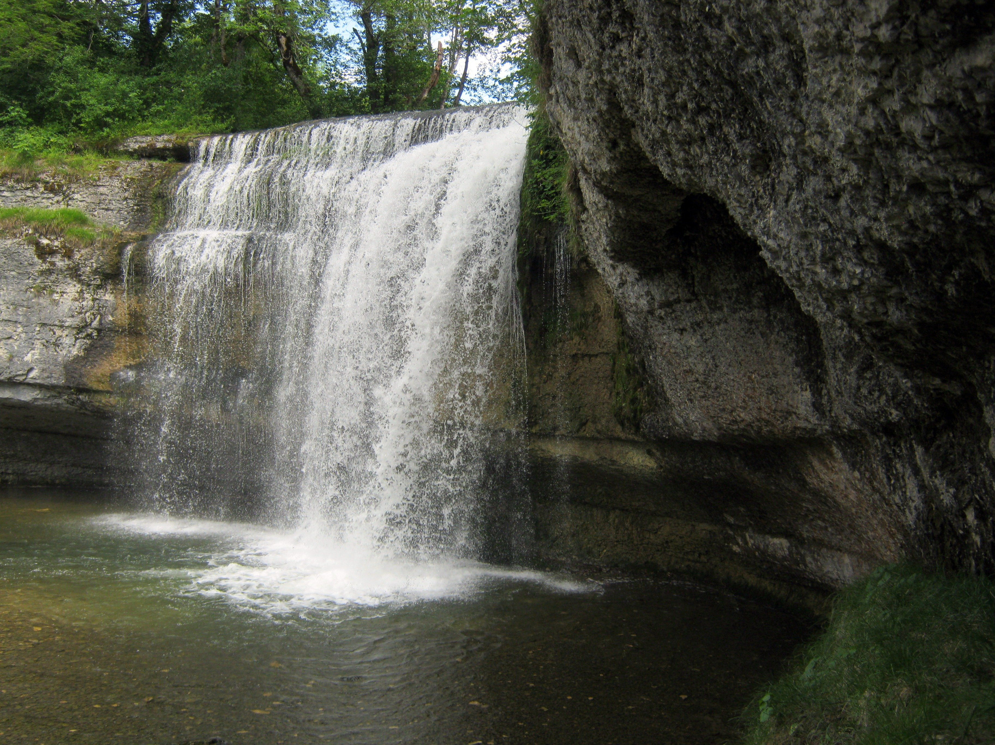
Hard Rock
Soft Rock
Waterfall (image number 260428) © Steinchen, Pixabay

Slide 4

Step

Slide 5
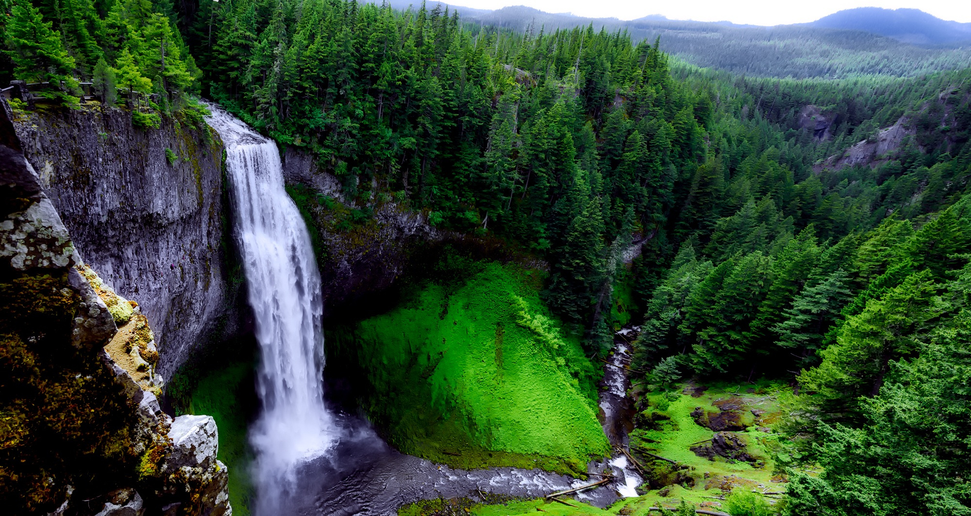
Plunge Pool

