Slide 1
www.thewaterdiaries.com

Slide 2
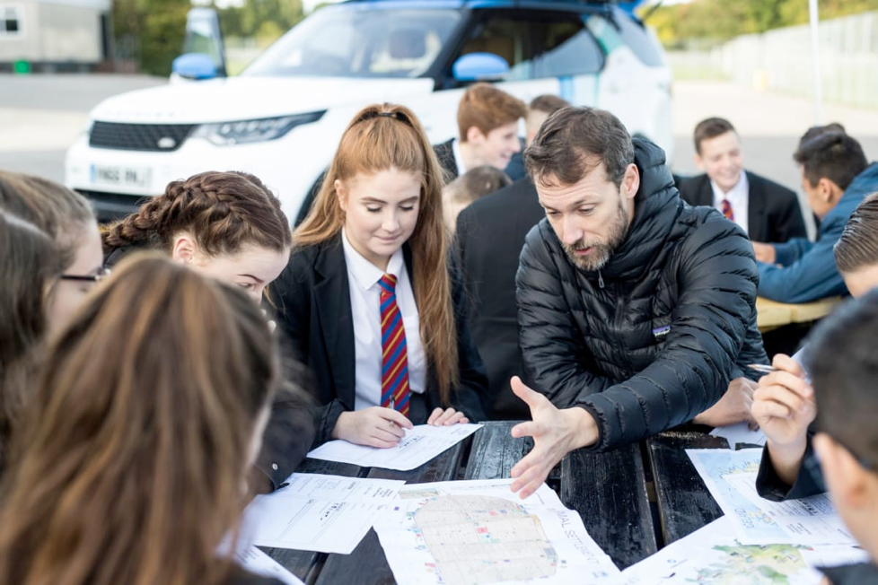
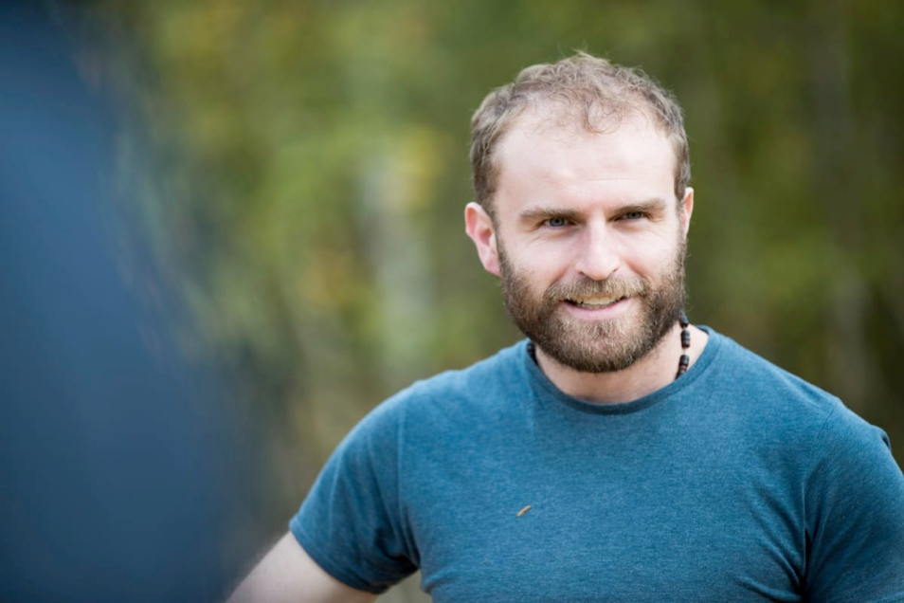
The water diaries team
Winners of the RGS Land Rover Bursary 2017. The team drove a new model Discovery across Jordan to investigate Water Issues.
Temujin Doran
Fearghal O'Nuallain
Shane McGuinness
Filmmaker
Teacher | Lead
Field Scientist
www.thewaterdiaries.com

Slide 3
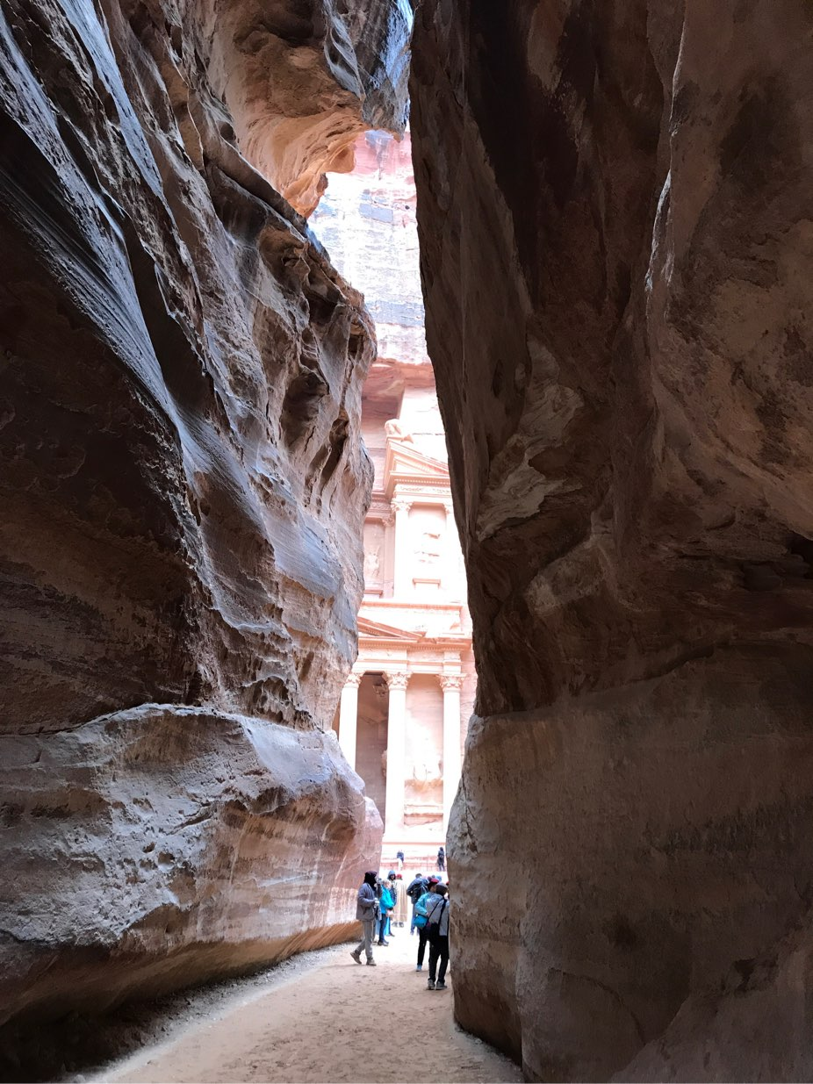
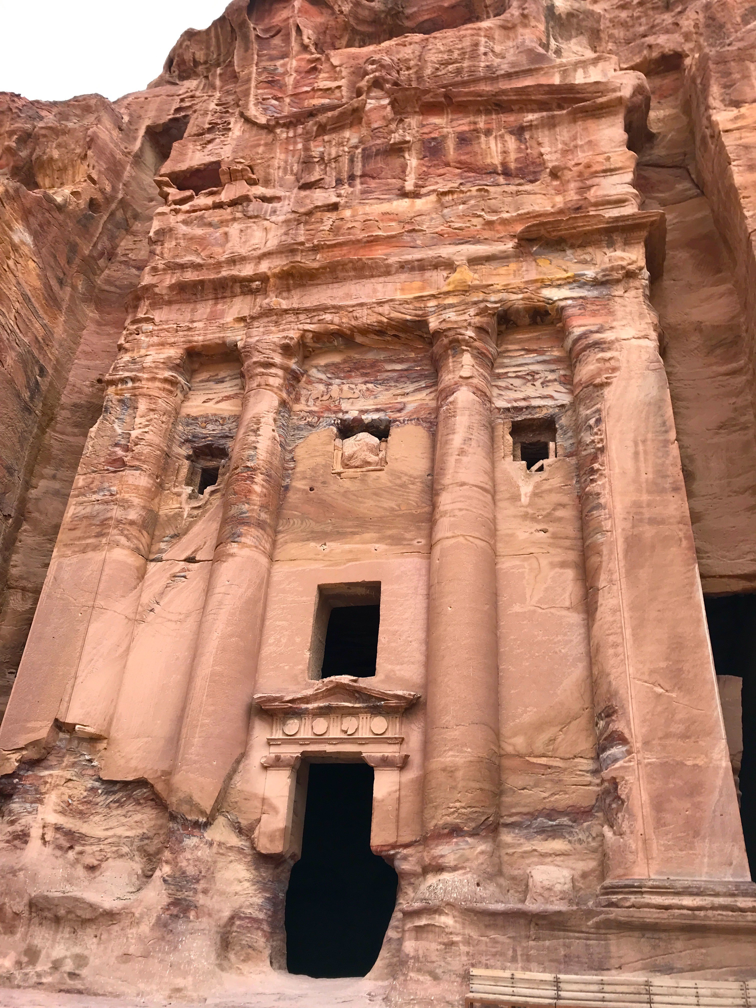
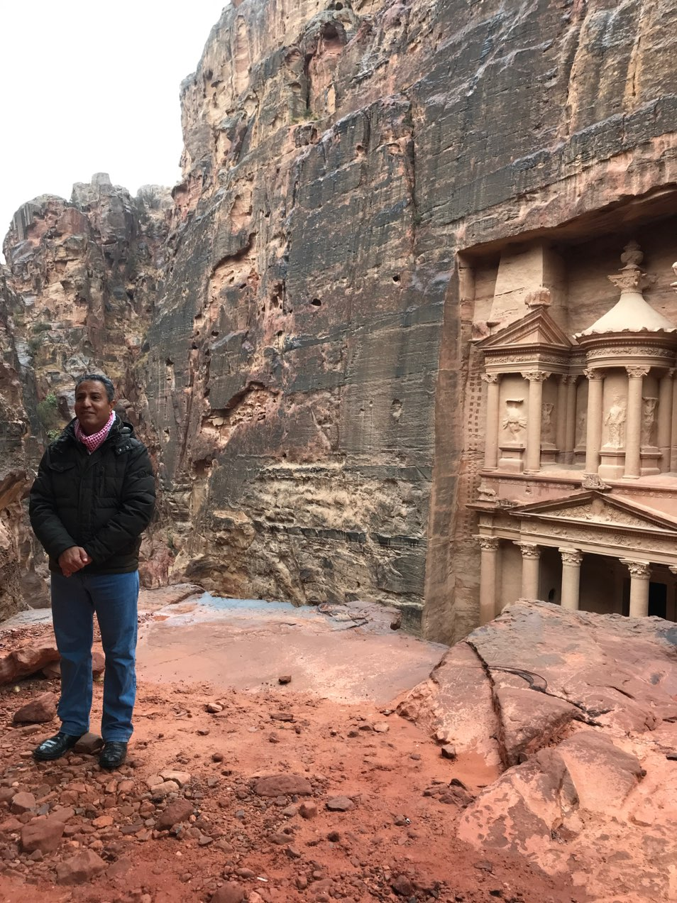
Teacher
Brief
Petra - Decision Making Exercise
www.thewaterdiaries.com

Slide 4
Teacher
Brief
This lesson focuses on the Ancient City of Petra to engage with climate and develop graphing and decision making skills.
Students will listen to an interview with an Dr Sami Alhasanat on Petra to learn how important water was to the ancient Nabateans then investigate the ancient site using digital maps to get an understanding of the area.
Then they will create a climate graph using temperature and precipitation data and apply their knowledge to make a real world decision as a film location scout.
www.thewaterdiaries.com

Slide 5
Teacher
Brief
PETRA - DECISION MAKING EXERCISE
A C T I V I T I E S
T H I S D E C K C O N T A I N S:
LOCATING
INTERVIEW
MaPPING
Researching
DEcision
MAking
Graphing
www.thewaterdiaries.com

Slide 6
Teacher
Brief
Climate Graphs at Petra
S K I L L S
Literacy
Graphicacy
Decision Making
Map Reading
Numeracy
www.thewaterdiaries.com

Slide 7
Teacher
Brief
Climate Graphs at Petra
A C T I V I T Y T I M I N G S
Total Duration
2.5hrs
This unit consists of 2.5hrs total teaching content for 14-16ys. Each activity can be taught alone or several can be taught together. See the chart below for individual timings.
Researching
40mins
Decision
Making
40mins
Graphing
40mins
Interview
20mins
Mapping
20mins
www.thewaterdiaries.com

Slide 8
Teacher
Brief
FOR THIS LESSON YOU WILL NEED:
PRINT RESOURCES
PENCILS & RULERS
GRAPH PAPER
Internet Access
Print X1 sheet per student for each activity click the red words to download sheets.
Each student will need a pencil and a ruler for the graphing activity.
X1 sheet of graph paper per student for the graph exercise.
Internet access will be required to view the online map and interview.
www.thewaterdiaries.com

Slide 9
Teacher
Brief
“PETRA - Decision Making Exercise”
O V E R V I E W
Duration - 120mins
Level - 14-16
Description - This resource focuses on the Ancient City of Petra in Jordan. It is composed of a collection of activities that can be used separately or as a scheme of work building towards a Decision Making Exercise.
Objectives - Develop and apply graphicacy, numeracy and digital mapping skills to make a practical decision about Petra’s suitability as a film location.
Outcome - by the end of this scheme of work students will have created a fact file on water use in Petra, investigated the site using digital mapping, created a climate graph, and employed a suite of Geographical skills to make a real world business decision.
www.thewaterdiaries.com

Slide 10
Climate Graphs at Petra
www.thewaterdiaries.com

Slide 11
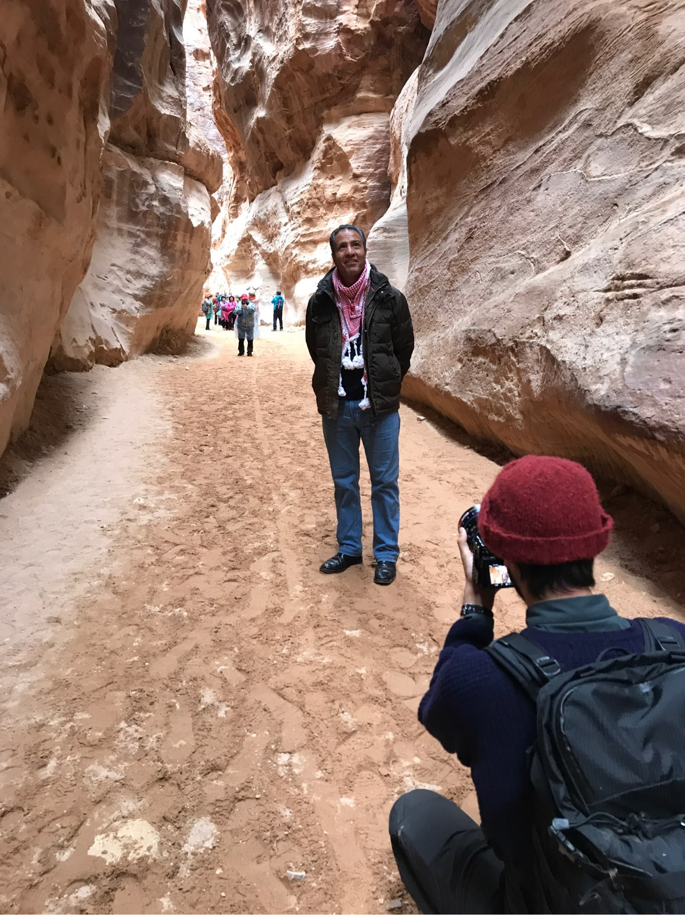
INTERVIEW
Watch the interview with Dr Sami al-Hasanat and answer the questions on the sheet provided.
www.thewaterdiaries.com

Slide 12
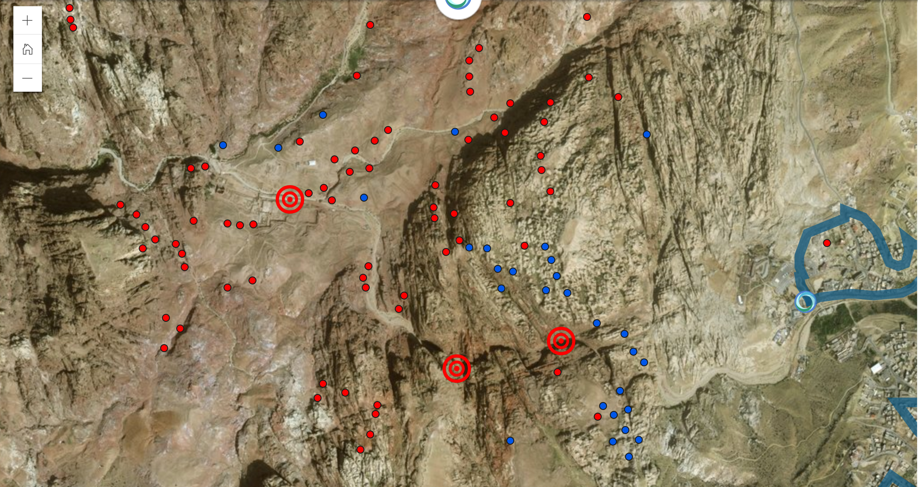
MaPPING
Read the fact file and Explore Petra on The Water Diaries expedition map.
Develop X5 questions and answers about Petra using the information from both.
www.thewaterdiaries.com

Slide 13
EXPLORING
www.thewaterdiaries.com

Slide 14
Graphing
Why was water management so important to the people who lived in Petra?
Use the data on the following slide provided to create a graph showing the precipitation and temperature in Petra and answer the questions about its climate.
www.thewaterdiaries.com

Slide 15
Graphing
Use the data provided to create a climate graph:
 | Jan | Feb | Mar | Apr | May | Jun | Jul | Aug | Sep | Oct | Nov | Dec
Temperature | 8°C | 9°C | 10°C | 15°C | 19°C | 22°C | 25°C | 25°C | 23°C | 18°C | 14°C | 10°C
Precipitation | 110mm | 82mm | 60mm | 38mm | 28mm | 10mm | 6mm | 5mm | 18mm | 34mm | 82mm | 120mm
Rainy Days | 4 | 3 | 7 | 4 | 2 | 0 | 1 | 0 | 0 | 2 | 1 | 5
www.thewaterdiaries.com

Slide 16
Graphing
www.thewaterdiaries.com

Slide 17
Researching
Read articles (1 & 2) and add additional notes to your fact file.
www.thewaterdiaries.com

Slide 18
Decision
making
Imagine you are a location scout for the Indiana Jones film.
The director wants a location that fits his budget, is easy to get to and that the actors will be happy with.
Use the worksheet to evaluate Petra as a filming location.
www.thewaterdiaries.com

Slide 19
Petra - Decision Making Exercise
www.thewaterdiaries.com

Slide 20
The water diaries team
Temujin Doran
Fearghal O'Nuallain
Shane McGuinness
Filmmaker
Teacher | Lead
Field Scientist
www.thewaterdiaries.com

Slide 21
SUPPORTED BY
THE RGS LAND ROVER BURSARY 2017
www.thewaterdiaries.com

